Slide 1
Business
Our Stories: The History of Maratho County Exhibit
Marathon County Historical Society
State Standards:
B.8.1 Interpret the past using a variety of sources, such as biographies, diaries, journals, artifacts, eyewitness interviews, and other primary source materials, and evaluate the credibility of sources used
D.8.4 Describe how investments in human and physical capital, including new technology, affect standard of living and quality of life
D.8.7 Identify the location of concentrations of selected natural resources and describe how their acquisition and distribution generates trade and shapes economic patterns

Slide 2
You move to a desolate piece of land, what supplies will you run out of first?
Clothes?
Tools?
Food?
Where do you get these supplies today?

Slide 3
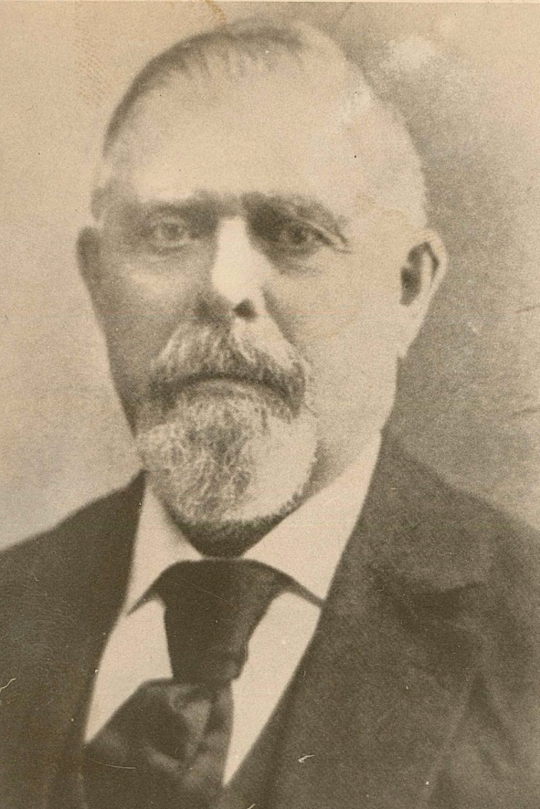
Where do you think early settlers replaced their dwindling supplies?
Merchants like August Kickbusch, brought wagons filled with supplies to sell

Slide 4
What about stores?
As the population grew rapidly, so did retail shops.
Businesses listed in the 1905 Wausau City Directory
100 dressmakers 28 grocers
12 music teachers 19 confectioners
10 cigar makers 7 milliners
4 druggists 18 hotels
10 meat markets 8 tailors
10 barbers
Do these businesses still exist today?
What has happened to them?

Slide 5
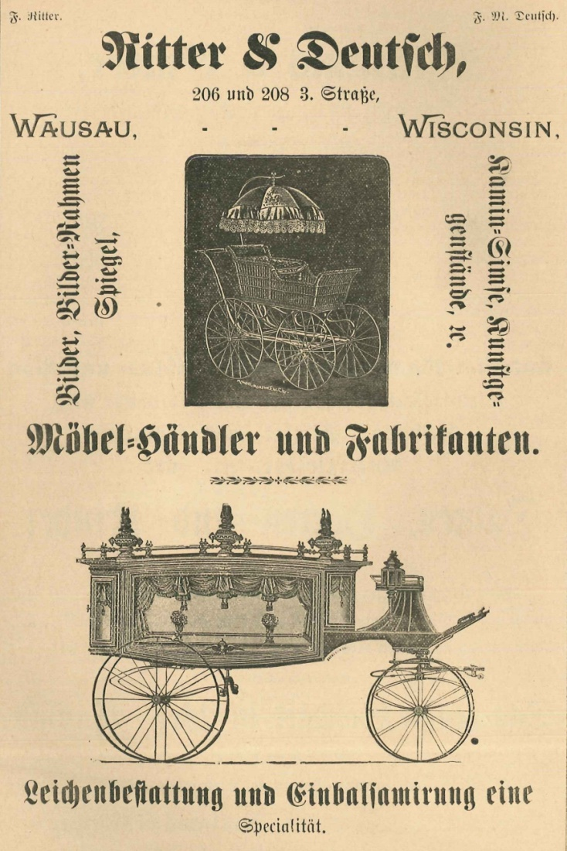
Advertising
Since the majority of the population was from Germany and spoke German, many stores made German advertisements
What languages are advertisements in today?

Slide 6
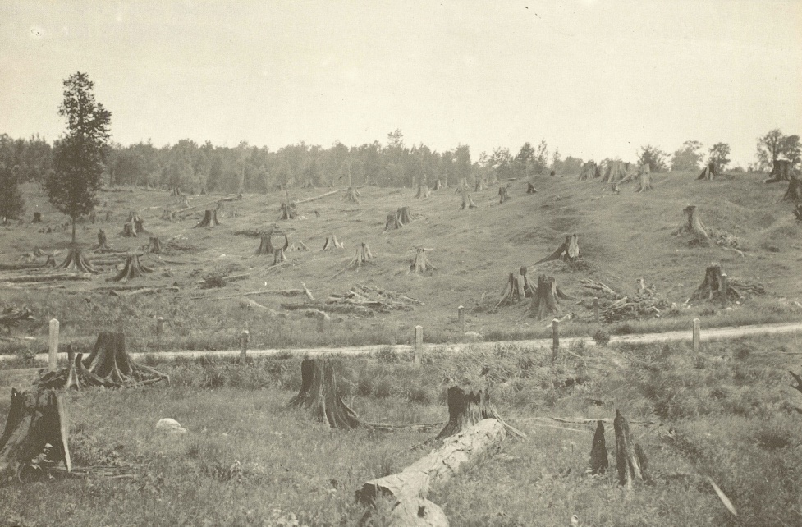
What happens to the loggers when the trees have all been cut down?
They go home and find new jobs.
The lumber and saw mills close.
New industry is created in its place.
All of the above

Slide 7
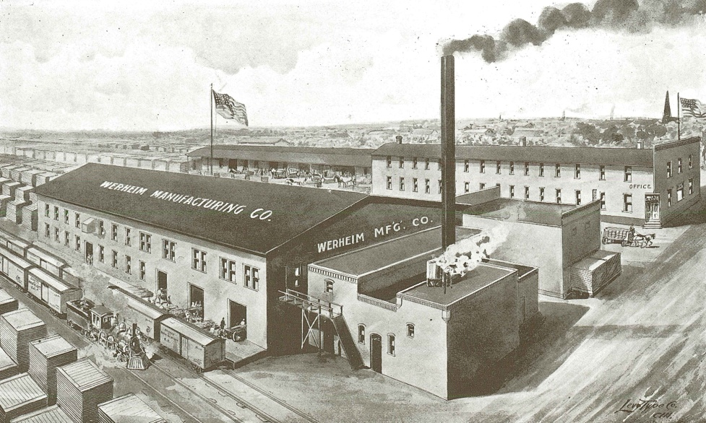
What else can you make out of wood besides lumber?
Excelsior Companies made packing materials
Box factories made wooden shipping boxes
Werheim Manufacturing Company made wood trim, window molding, and doors.
Paper Mills began

Slide 8
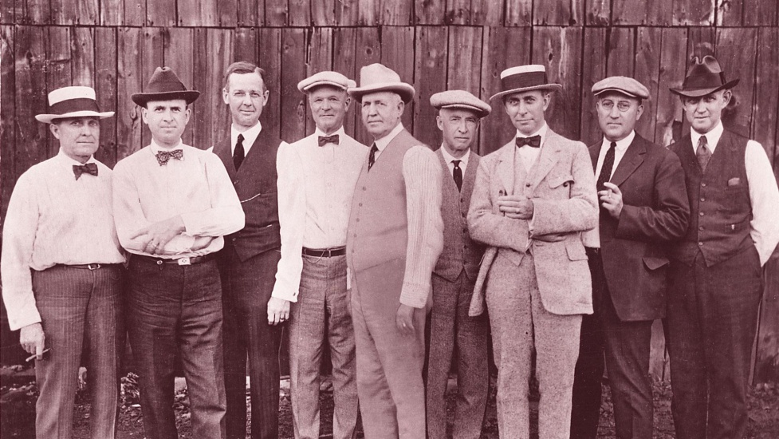
"The Wausau Group"
These prominent business leaders met in 1901 to discuss how to revitalize the local economy.
They helped create paper mills, the electric trolley line in Wausau, and created Employers Mutual Liability Insurance Company.

Slide 9
What local business today were formed in Wausau?
Greenheck
  1947 brothers Bernie and Bob Greenheck opened a metal shop in Schofield
  Mid 1990s sales topped $100 million due to excellent products
Wausau Tile
  Ed Creske began working in his Mosinee garage in 1953 making flooring and pebble covered waste containers
  Supplies companies like McDonalds
Eastbay
  In 1980 Art Juedes and Rick Gering began educating athletes about running shoes
  1995 sales exceeded $100 million; it is now owned by Footlocker

Slide 10
Discussion Questions
What happened when all the trees were cut down?
What can you make out of wood besides lumber?
If these companies had not opened would Wausau still be around today?
Name a business today that started in Marathon County.
Why are these large companies important to Wausau?
What would you like to be when you grow up? How is that job important to the community?

Slide 11
End of Business Presentation

