Slide 1
Farming and Dairy in the 1870s
Our Stories: The History of Marathon County Exhibit
Marathon County Historical Society
State Standards:
B.8.1 Interpret the past using a variety of sources, such as biographies, diaries, journals, artifacts, eyewitness interviews, and other primary source materials, and evaluate the credibility of sources used.
B.8.8 Identify major scientific discoveries and technological innovations and describe their social and economic effects on society.
D.8.9 Explain why the earning power of workers depends on their productivity and the market value of what they produce.

Slide 2
Who is a Farmer?
Permanent settlers hoping to secure the American Dream.
In the late 1870s the government sold land for $2 an acre in 80 acre parcels.
Many German and Irish immigrants took this offer.
The land was cheap, but it needed a lot of work before a crop could be planted.

Slide 3
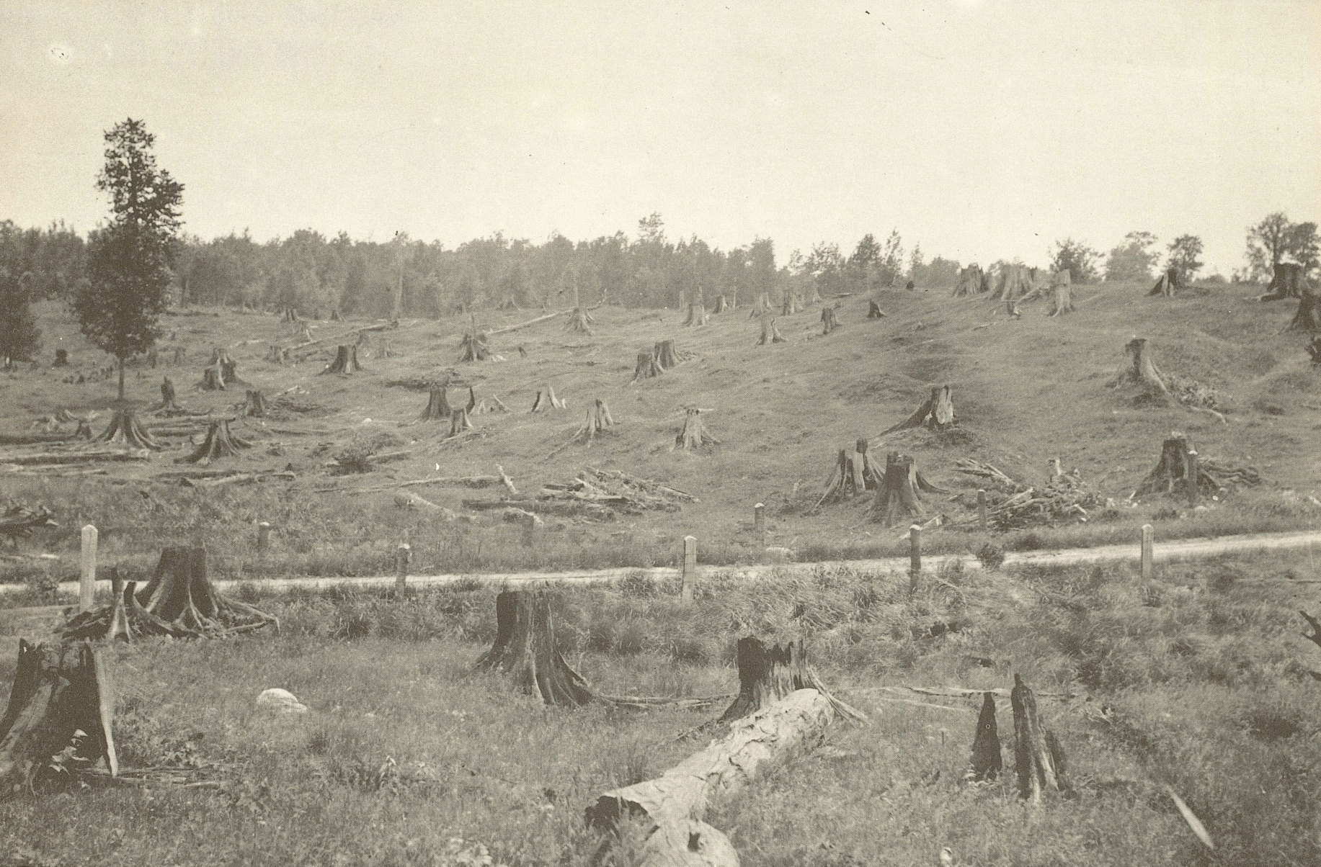
How do you clear the land of trees and stumps?

Slide 4
How did his grandfather clear the land?
“My grandfather started a farm from woods, you might say. It was all woods at the time. I can often hear my grandfather tell about when they came, everything was woods and they had to cut down the trees and burn them and grub some land in order to get a harvest. They had pretty tough times in those days.”
-Harry Metzke

Slide 5
How did she clear the land?
“After the timber was cut, the pine stumps and roots were first blasted with dynamite, then the horses had to pull the stones, the huge boulders, which this good soil seemed to have. (We have) loads and loads of stones on wagons to clear the land for cultivation.”
-Adella Radtke Cline
Which technique do you choose?

Slide 6
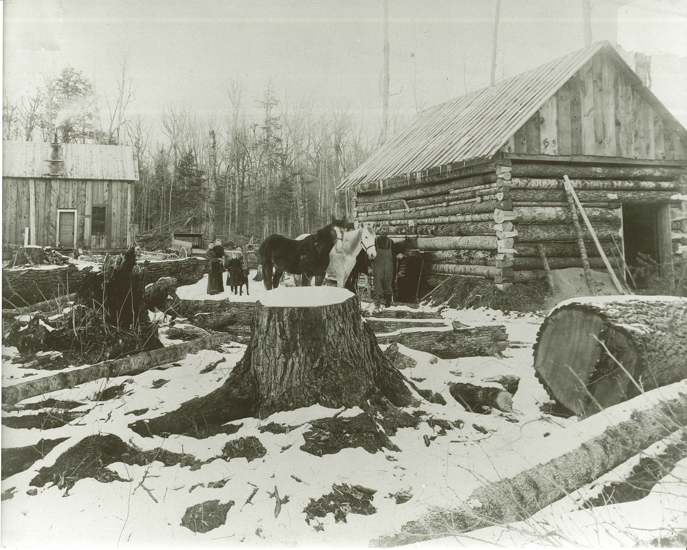
How did early farmes make ends meet?
Subsistence farming, growing only enough food to feed your family was most common.
Rocky soil and leftover stumps mad farming difficult .
Many farmers worked additional jobs, such as logging during the winter.

Slide 7
Why Dairy Cows?
They saved your back!
Cows could prosper on smaller pieces of land with stumps and rocks in it.
But now, what do you do with all the milk?

Slide 8
Cheese factories were built
Due refrigerators not being invented yet, farmers had to have their milk processed 7 days a week into cheese.
By the 1920s cheese factories had formed cooperatives.
Cheese factories became the center of rural communities.
In fact, some cheese factories were the only place in the area with a telephone and electricity!
Can you name a local cheese factory?

Slide 9
Dairy Economy
“Some of my competitors were in bulk already, picking up bulk milk from the farms. I couldn’t sit back and lose all my big farmers so I went out and bought a brand new 1958 truck and brand new stainless steel tank. I bought a bunch of bulk tanks and put them into farms, set them up. There were some bigger plants around me that were taking my farmers, my big farmers. I could not afford to lose my big farms.”
-Charles Mullins, 1958
Pioneer Cheese Factory

Slide 10
Was every part of the milk used?
“We milked 14 or 16 cows. We hauled (the milk) to a cheese factory two miles away. First it was a creamery, they made butter, and then cheese got to be the important thing, so they separated for cheese. The whey was dumped and later on they said, shucks, we better skim that whey and make butter out of the cream from the fat that was in there. The rest of it was mainly dumped. Then they found that it was good hog feed.”
-Ema Zimmermann

Slide 11
Discussion Questions
Why is dairy farming prominent in Marathon County?
How did they choose which crops to grow?
Would you have put in all the work to start a farm?
How else could new settlers in Marathon County make money?

Slide 12
End of Farming and Dairy Presentation

