Slide 1
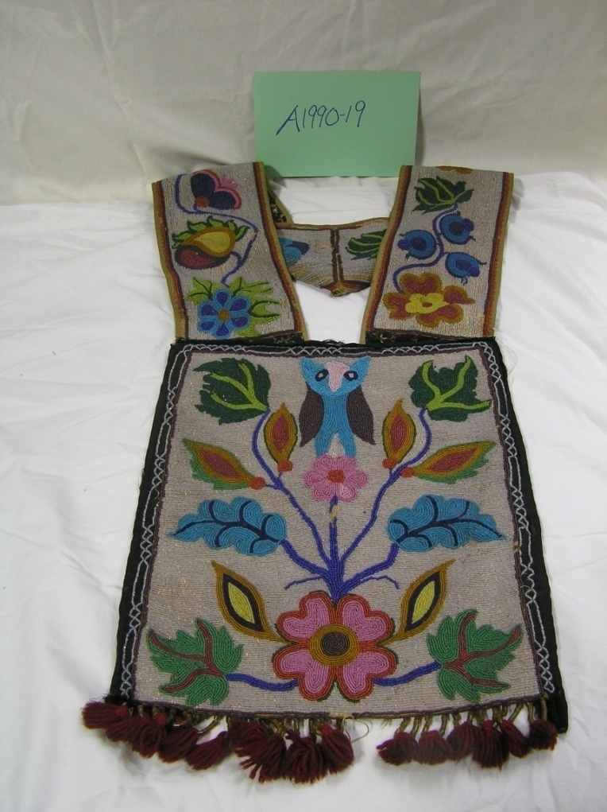
The First People
Our Stories: The History of Marathon County Exhibit
Marathon County Historical Society
Standards:
B.4.4 Compare and contrast changes in contemporary life with life in the past by looking at social, economic, political, and cultural roles played by individual groups
B.4.9 Describe examples of cooperation and interdependence among individuals, groups, and nations

Slide 2

If you couldn’t go to the store or a kitchen, how would you get food to eat?
Fishing
Hunting
Gathering

Slide 3
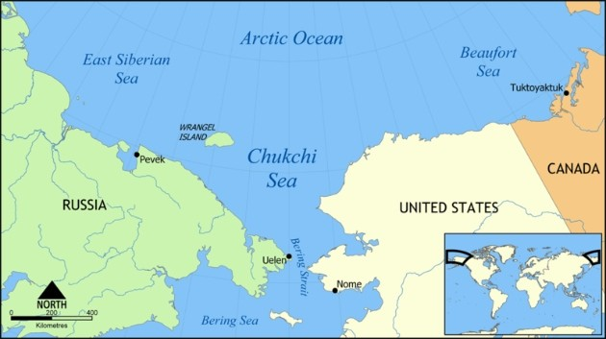
Who Were the First People?
The first people to step foot on North America were called Paleo-Indians.
They came across the Bering Strait land bridge over 11,000 years ago.

Slide 4
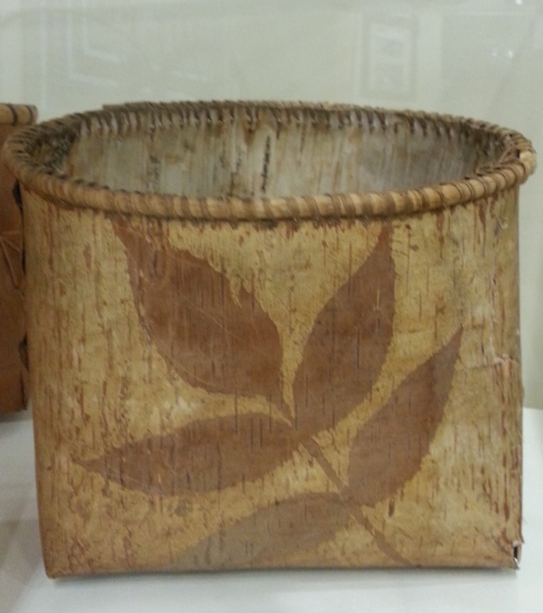
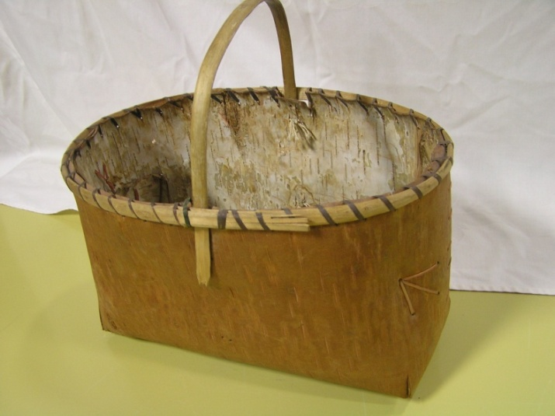
Why did the First People Come to Wisconsin?
They came because they were following their dinner, it moved, so they moved. This is called semi-nomadic living.
Once the small groups arrived in Wisconsin they continued to hunt game and gather berries, vegetables, and grasses. This is called being a hunter-gatherer.

Slide 5
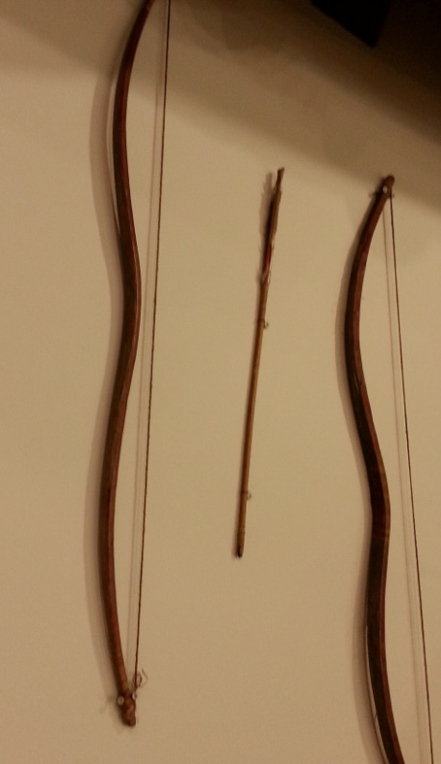
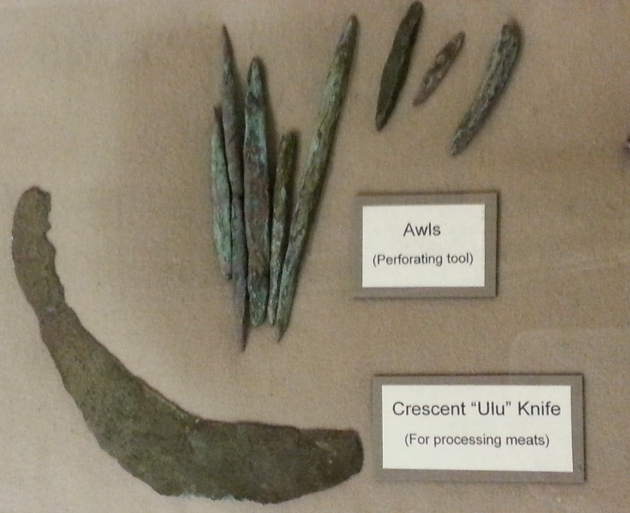
If the First People were semi-nomadic, why did they stay in Wisconsin?
The First People found raw materials they used for tools and trade.
Copper, stone, wood, and bone were found.

Slide 6
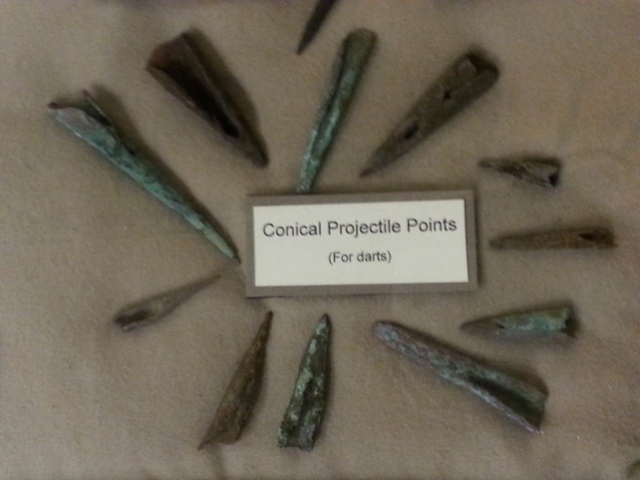
Why don’t we call the Native Americans Paleo-Indians today?
Over time the Paleo-Indians broke into smaller groups forming the tribes we know today.
One of the prolific cultures in our region was the “Great Lakes Copper Culture.”
Can you infer why they were known as the “Copper Culture?”

Slide 7
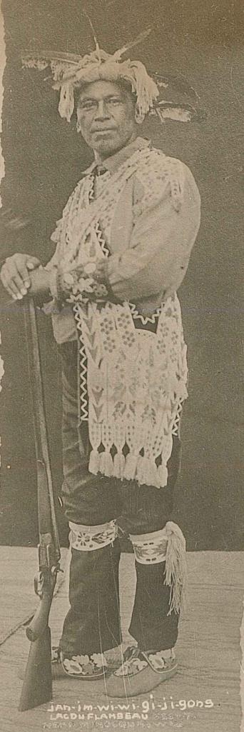
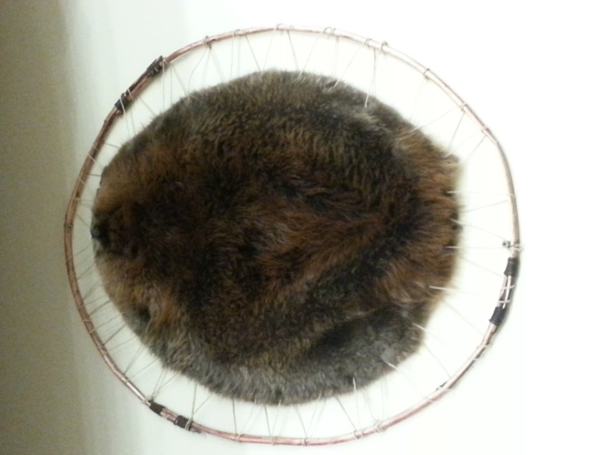
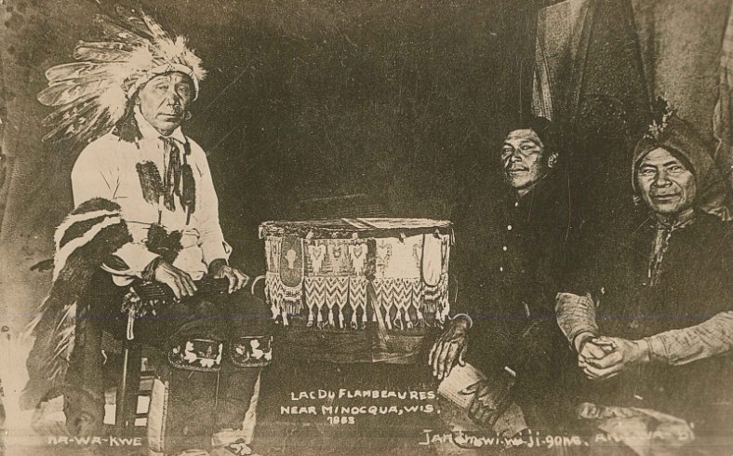
Who was the biggest tribe in Northern Wisconsin?
The Ojibwe also known as the Chippewa were the primary occupants of northern Wisconsin. Local tribes also included the Menomonie and Lac du Flambeau.
Beginning in the early 1600s French fur traders bartered with the Native Americans for beaver pelts.
Notes:
Make a list of the tribes in Wisconsin.

Slide 8
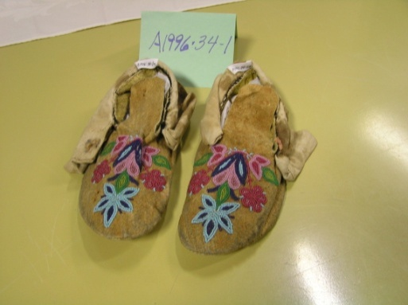
Predict: Did the Fur Traders and Native Americans get along?
The Native Americans embraced trade with the French.
The groups formed an alliances, they slowly became dependent on each other’s goods.
The Native Americans relied on European foods, beads, and metal implements.
The Europeans relied on the animal pelts.

Slide 9
How would you react to the news, you must leave your house immediately?
As European settlers and lumber speculators moved to Marathon County, the government moved the original inhabitants from their lands.
The Native Americans and other tribes were forced to leave their land and move to reservations.
Are there any reservations close to Marathon County?

Slide 10
How did the First People Travel?
Walking
On rivers and lakes
  Used handmade canoes like the one in the video
  Make sure to look up for the canoe when you visit the exhibit!
Click on this box for a short video on restoring the canoe in the exhibit.
Notes:
The picture video is 4:10 minutes, it does not have sound, it is only pictures.

Slide 11
How are the First People related to the Native Americans today?
Why did Europeans focus on Wisconsin?
How did Europeans change the Native lifestyle? Was it good or bad?
Did the Native Americans have a choice to interact with Europeans? Why or why not?
How can you use what you have learned about the relationship between the Europeans and the Native Americans next time you meet a new group of people?

Slide 12
End of First People Presentation

