Slide 1
How We Have Fun
Our Stories: The History of Marathon County Exhibit
Marathon County Historical Society
State Standards:
B.4.1 Identify and examine various sources of information that are used for constructing an understanding of the past, such as artifacts, documents, letters, diaries, maps, textbooks, photos, paintings, architecture, oral presentations, graphs, and charts
B.4.4 Compare and contrast changes in contemporary life with life in the past by looking at social, economic, political, and cultural roles played by individuals and groups
E.4.3 Describe how families are alike and different, comparing characteristics such as size, hobbies, celebrations, where families live, and how they make a living

Slide 2
What do you do for fun in Marathon County?
Skiing
Swimming
Movies
Parades
Fairs
Curling

Slide 3
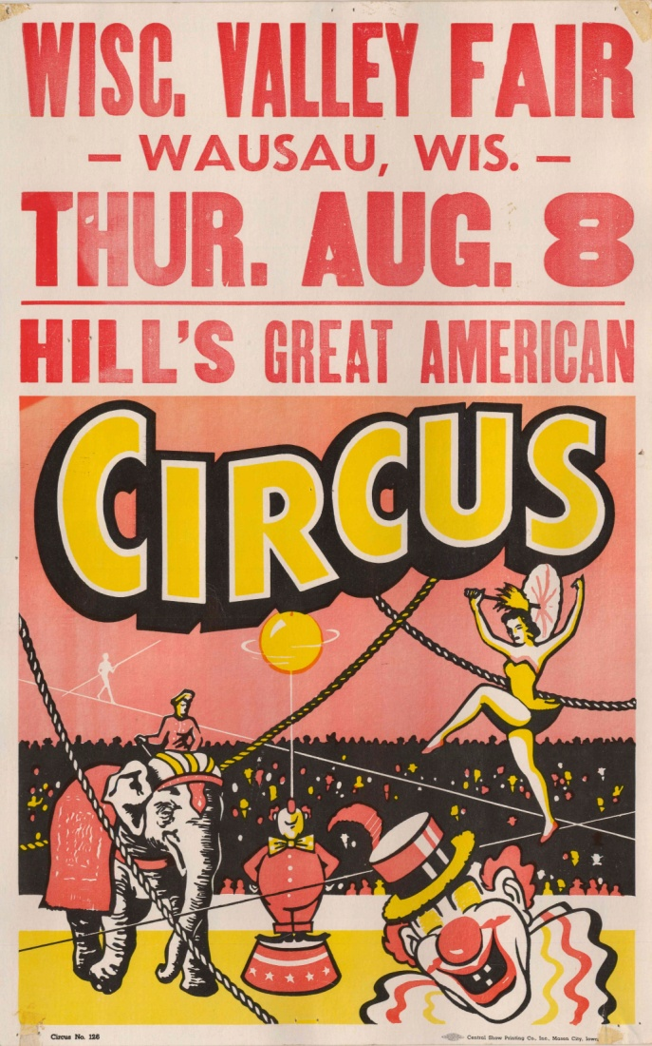
Early 1900s Circus at Marathon Park
“We watched the parade down Third Street. Then we got to Marathon Park where the circus tent was placed.
“There was so tremendously much to see, the clowns took your attention, and the three rings. You wished you had more eyes so that you could see everything that was going on.”
-Erna Zimmerman

Slide 4
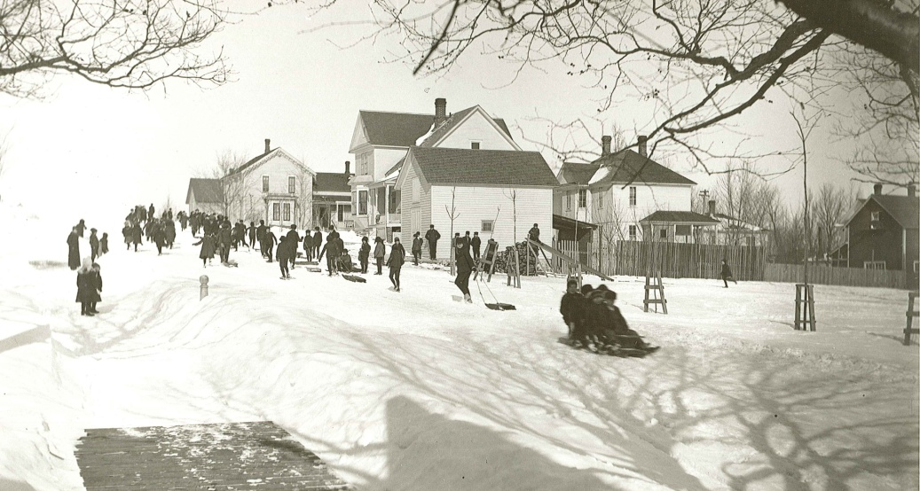
New Year's Eve in 1900
“Families used to enjoy sitting up till midnight listening to church bells and factory whistles saying “goodbye” to the tired old year and “hello” to the New Year.”
-Ottilie Mueller

Slide 5
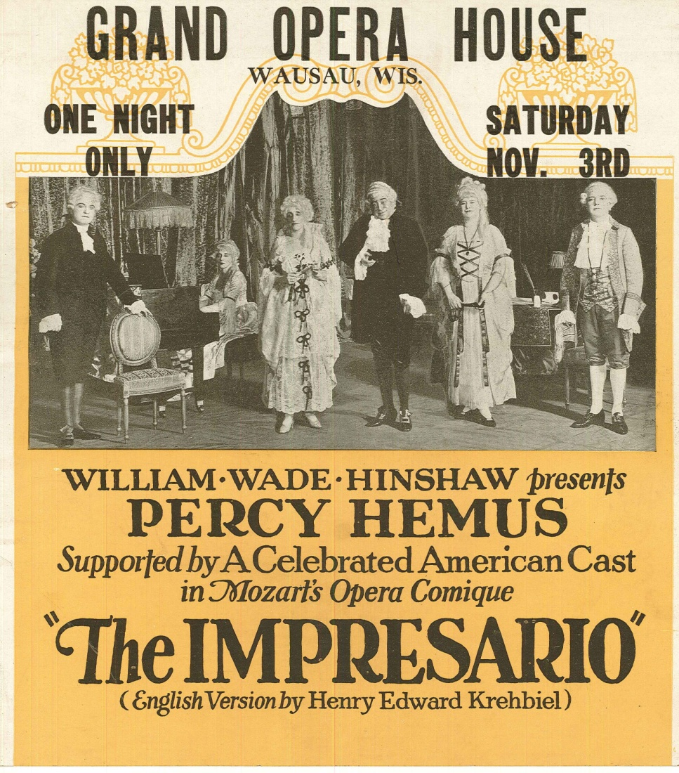
1920s Theaters in Wausau
“Movies were popular at the time. The Grand Theater was built about two years after I came here. There was a theater on Scott Street between First and Second and I recall it was called the Bijou. While they had movies there, they also had many stage shows. It was very popular because watching movies was a good deal. [People] didn’t have radios; they didn’t have movies in their home such as we have now.”
-Albert Papenfuss

Slide 6
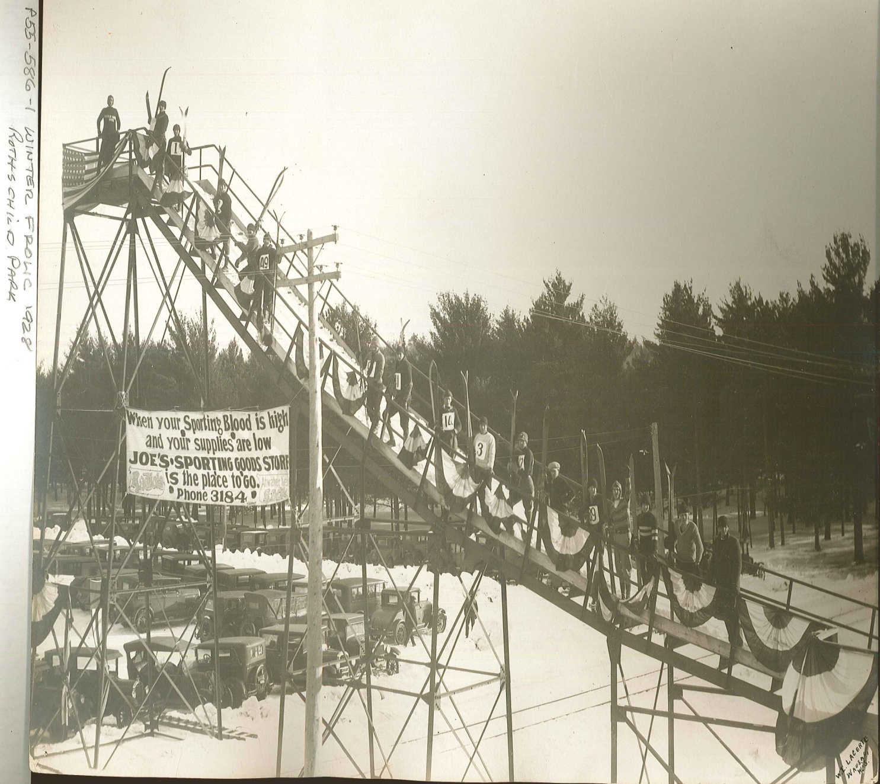
1920s Skiing
“We skied. We made our own skis. I went out in the woods and cut down the hickory tree and split it to the proper width and planed it and shaped it and I made a pair of skis. I made skis that when I stood them up they were taller than me in those days. I was still in school, so I have must have been 10 or 11. I never used poles.”
Ned Revie
Down hill and Cross-Country skiing were popular

Slide 7
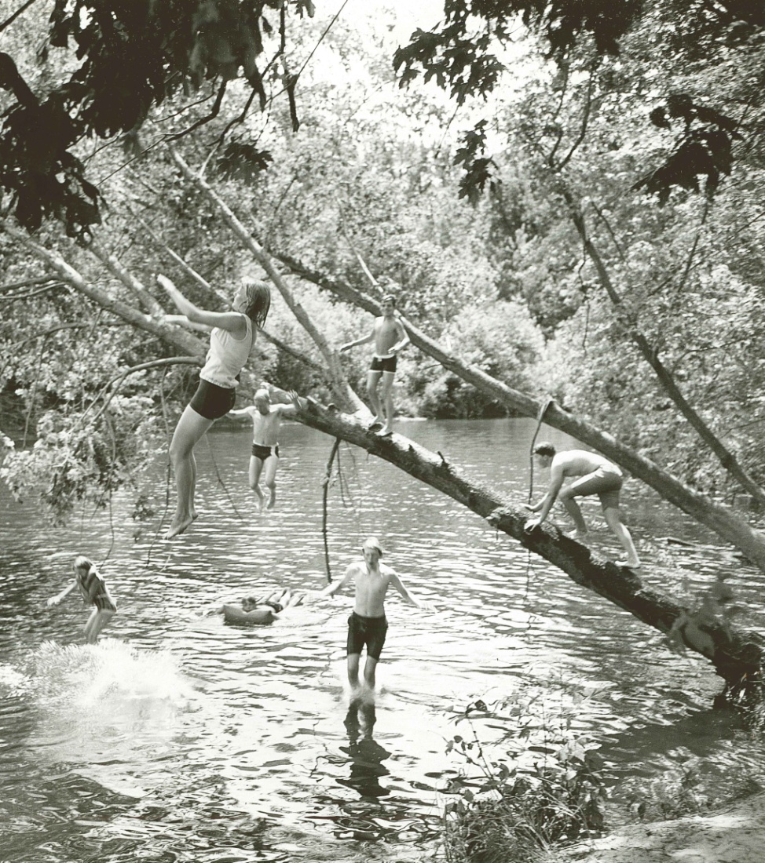
1920s Swimming by the Rib River
“That was down at the Rib River, my cousin Nola’s grandma’s farm. They had moved on to another farm but they still owned this land. There was an empty house and we could go in there and change into our swimsuits and we would swim in the Rib River. We all learned to swim there. The folks did too. Sometimes in the evening when we’d be out shocking grain, we’d be so hot and sweaty so we’d go down to the river and swim.”
-Lois Jorgensen

Slide 8
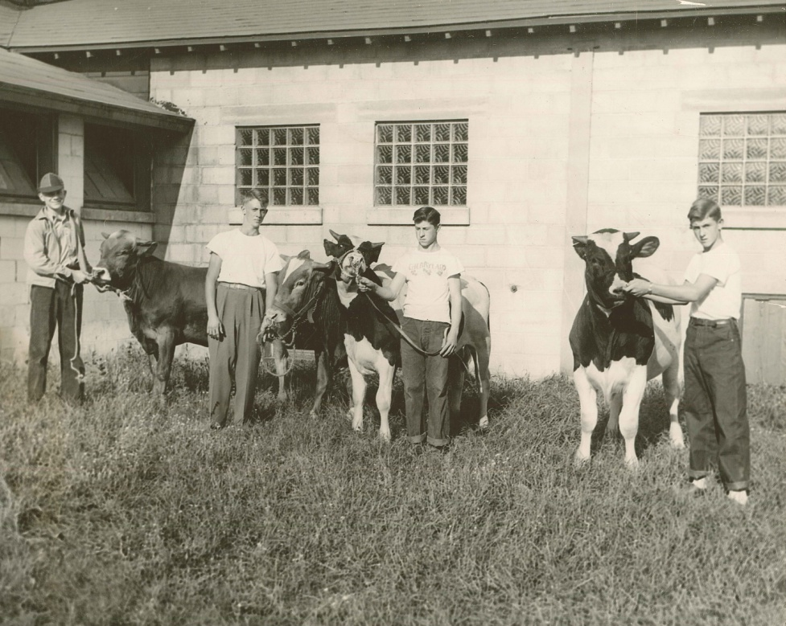
Showing Cows at the Fair in the 1950s
“After Christmas or even maybe in November you’d start looking at animals that you could take to the fair and decide which group you wanted to show in. Then you had to look at the animal as far as style, straight back, straight legs, how they held their head, their body and their chest and if they were milk animals then you had to look at the udders, but these were mostly young stock growing up to be cows. So you’d start keeping records of what you fed it. Then as soon as the weather broke you’d start to train them to lead, because they’d not had a halter on in their life. That was always pretty exciting to get them out of the barn.”
-Karl Block

Slide 9
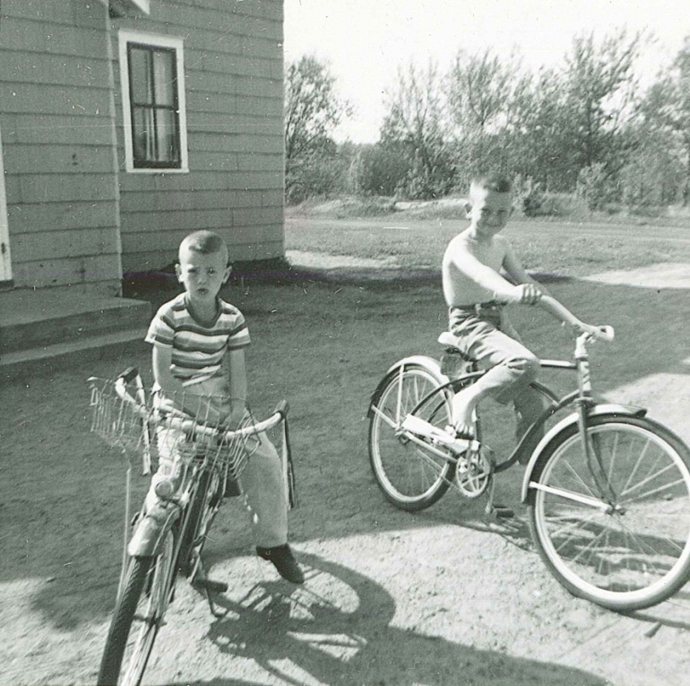
1940s-1950s Family Fun
“The big thing that rural people did in those days was celebrate the birthdays. Most of the relatives lived within a mile or two and they would congregate at the place where the birthday was. Of course the cousins came along or the neighbor boys and we’d play a lot of hide and go seek in the summer time and run in the cornfields in the fall. In the wintertime we would play cards.”
-Karl Block

Slide 10
Discussion Questions
Do you celebrate New Year’s Eve similarly or differently?
Would you prefer to go to a movie or a play? Do you think people in the 1920s would prefer a movie or a play? Why?
What use would skis have besides entertainment?
Have you learned to swim? Where? How?
Have you ever entered a contest? What did you have to do to prepare?
How do you celebrate birthdays?
Have the way people of Marathon County have fun changed much over the years?

Slide 11
End of How We Have Fun Presentation

