Slide 1
How to Write YOUR Story
We want YOU to be part of our exhibit!
Our Stories: The History of Marathon County Exhibit
Marathon County Historical Society

Slide 2
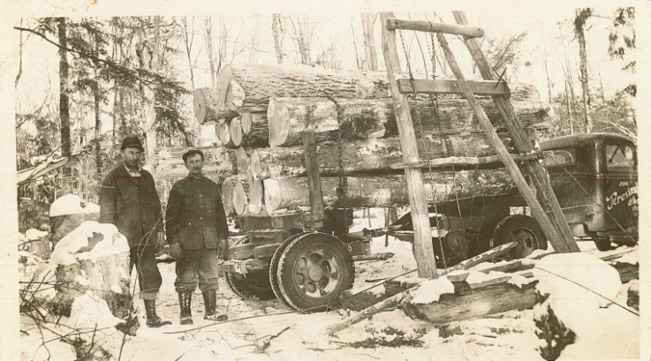
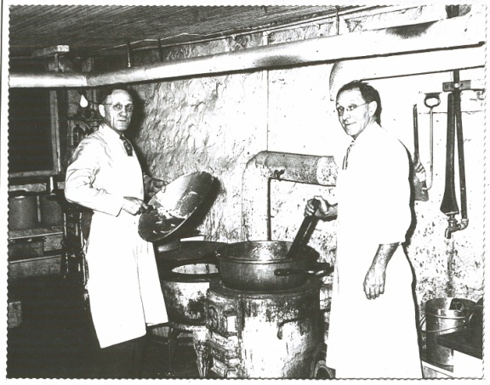
What is YOUR story about living in Marathon County?
You have heard, or will hear about
Moving to Marathon County
Growing up in Marathon County
Working in Marathon County
Having fun in Marathon County

Slide 3
We want to hear about your experiences living in Marathon County
Choose a specific experience you have had in Marathon County
It could be something you do with family, friends, or alone
In could be indoors or outdoors
It could be at home, at a relatives, friends, or at school
Write your story on the front of ONE page
Add a COLORFUL picture to your story
It could show you doing the activity
It could be a self portrait
It could be a place in Marathon County
It could be a photograph of you

Slide 4
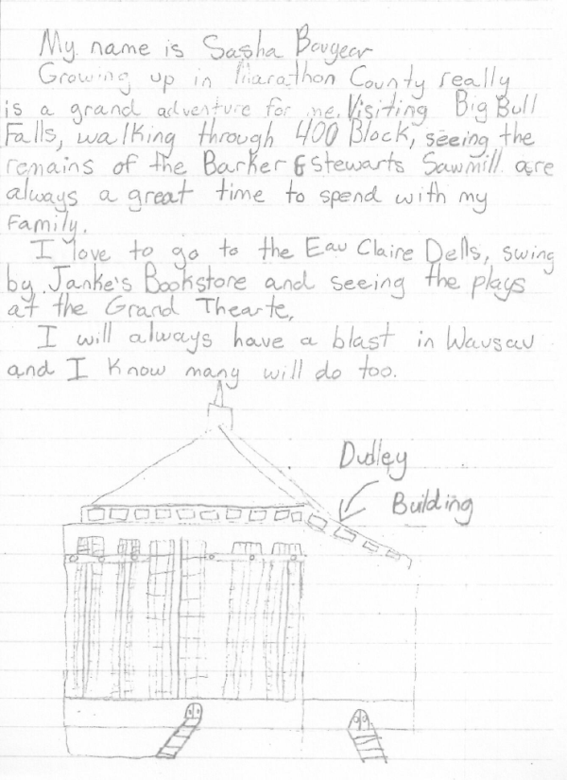
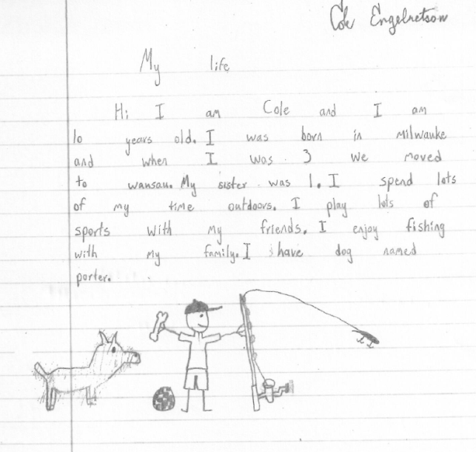
Examples of stories
Great picture !
Great event and picture!
Nice picture!
Wouldn’t these pictures be even better in color?

Slide 5
How to label your paper
First name only
Grade
School

Slide 6
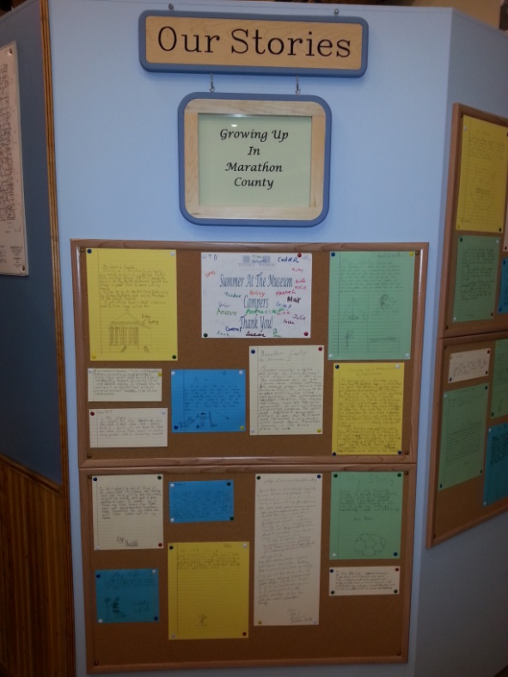
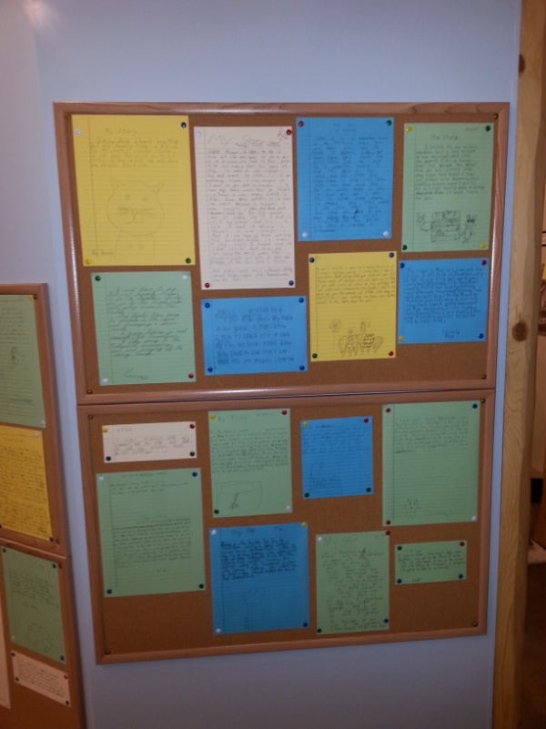
Turn your stories in to your teacher
The stories can be brought the day you visit the exhibit
Or
They may be sent by mail or dropped off at the museum

