Slide 1
Welcome to Our Stories: The History of Marathon County
Our Stories: The History of Marathon County Exhibit
Marathon County Historical Society

Slide 2
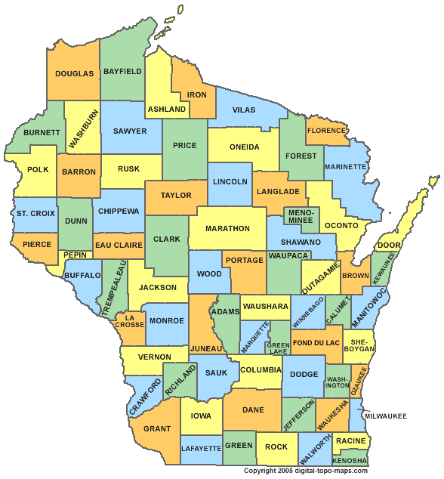
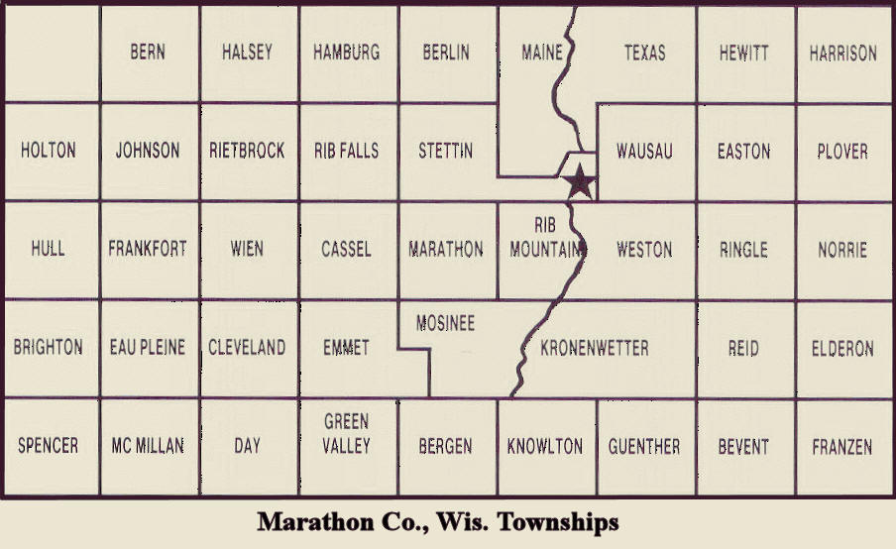
What is Marathon County?

Slide 3

If you couldn’t go to the store or a kitchen, how would you get food to eat?
Fishing
Hunting
Gathering

Slide 4
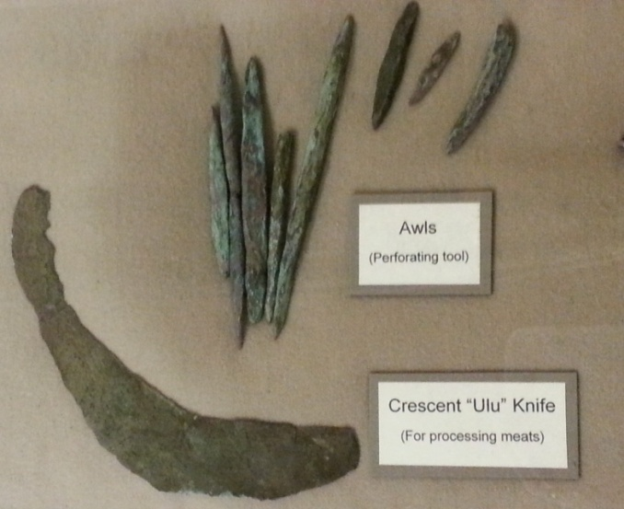
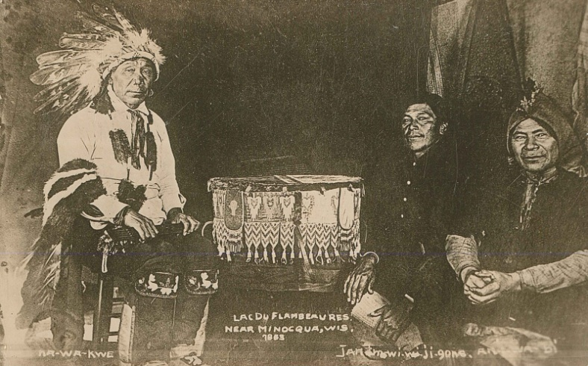
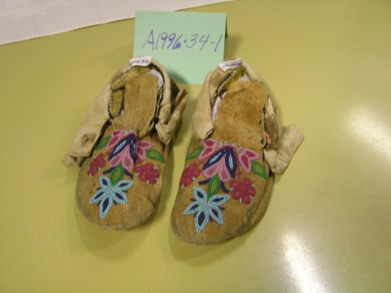
Native Americans
The first people to step foot on North America were called Paleo-Indians.
Eventually the Ojibwe or Chippewa tribes were formed in northern Wisconsin.
As European settlers moved to the area, the tribes were moved to reservations.

Slide 5
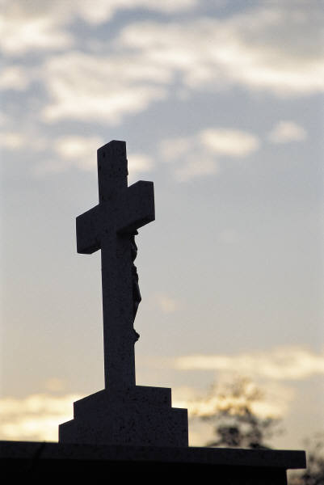

Why Leave Europe?
Economic
Religion
Military

Slide 6
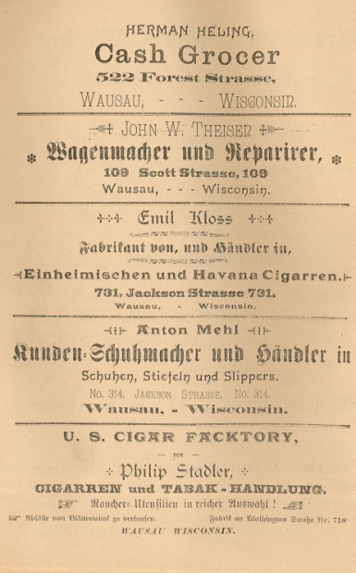
Immigrants
The vast forests for logging and the Wisconsin River and its tributaries enticed immigrants from other countries.
If immigrants could not afford the journey, August Kickbusch helped immigrants from Germany and Frederick Rietbrock recruited immigrants from Poland.
After the Vietnam Conflict, many immigrants from Laos and Vietnam came to Marathon County.

Slide 7
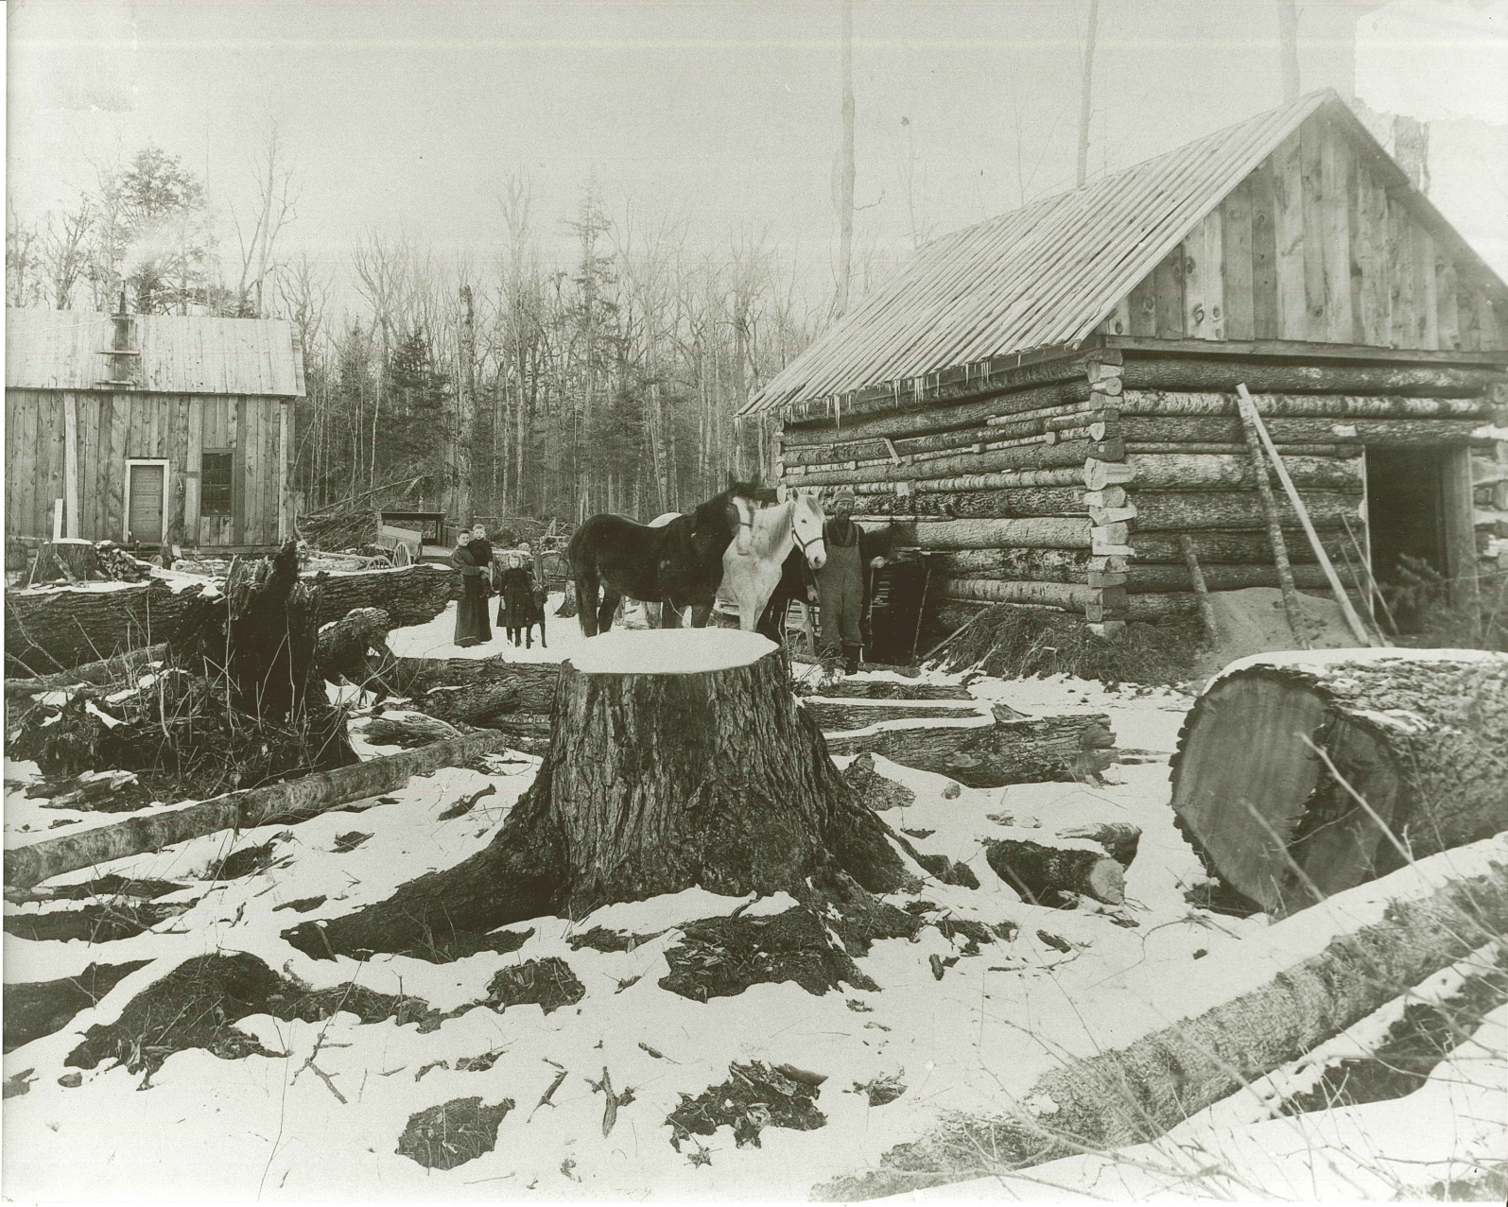
Farming and Dairy
Would you work to clear away stumps and rocks from your soil?
Most farmers were subsistence farmers, they only farmed enough land to feed their families.
Many farmers had to work additional jobs such as logging in the winter.
Would you be a Marathon County farmer in the 1870s?

Slide 8
Why Dairy Cows?
They saved your back!
Cows could prosper on smaller pieces of land with stumps and rocks in it.
But now, what do you do with all the milk?

Slide 9
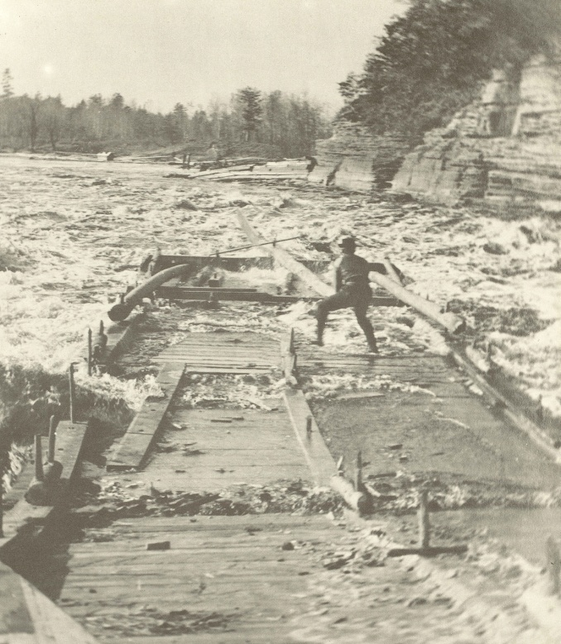
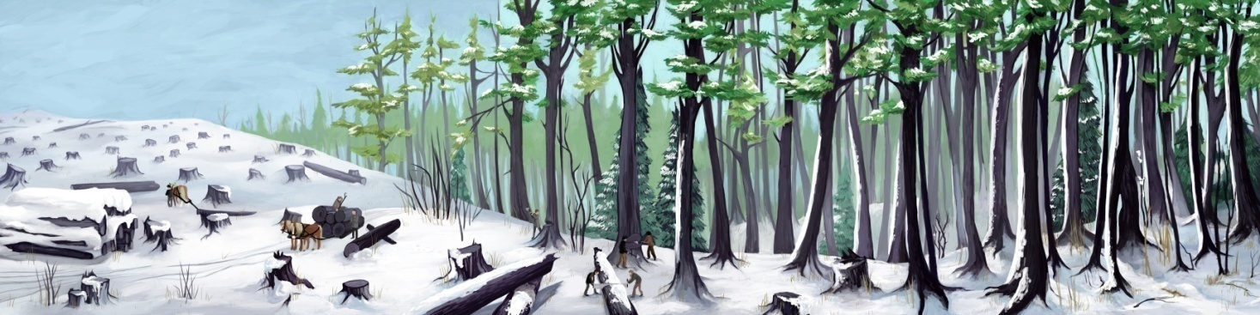
Logging
Logging was done in the winter.
It finished in time for the spring thaw of the Wisconsin River.
Logs were transported to sawmills and then on to lumber buyers.

Slide 10
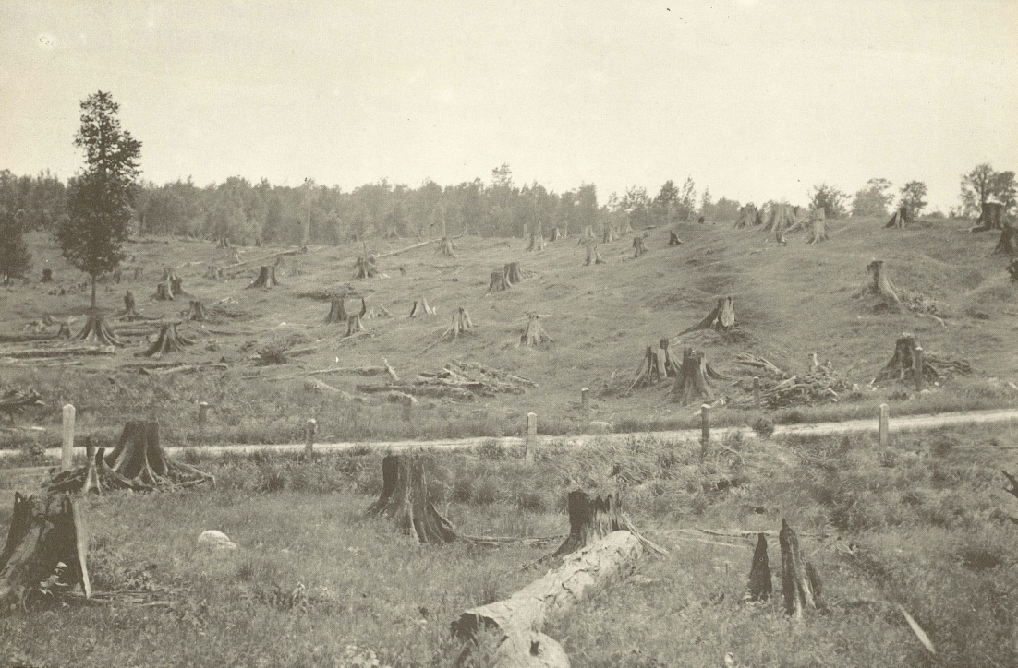
Do you think it is possible to cut down every tree in Marathon County?
Almost all of the trees were cut down by the early 1900s

Slide 11
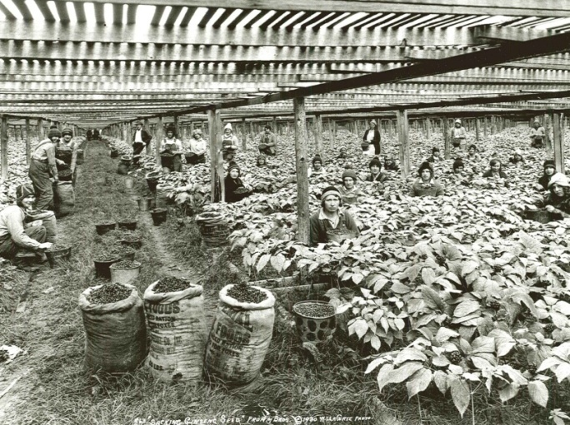

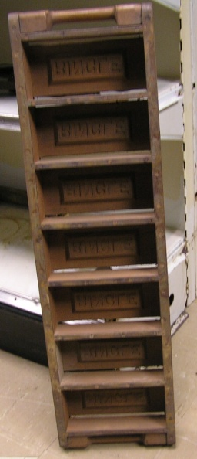
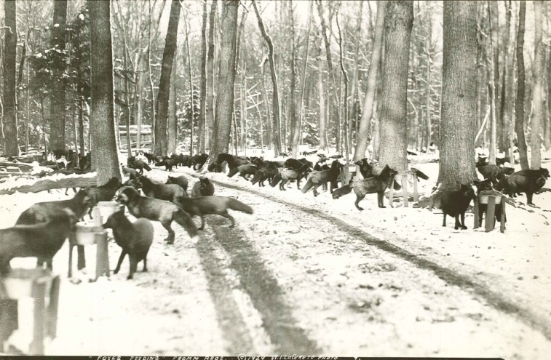
Marathon County Originals
Ginseng has been cultivated in Marathon County since the 1890s
In 1963 the Schuette brothers began delivering pre-built homes.
John Ringle’s land forced him to close his sawmill, but he used the clay to make bricks!
Early 1900s the Fromm’s brothers accomplished their dream of selling silver fox fur.

Slide 12
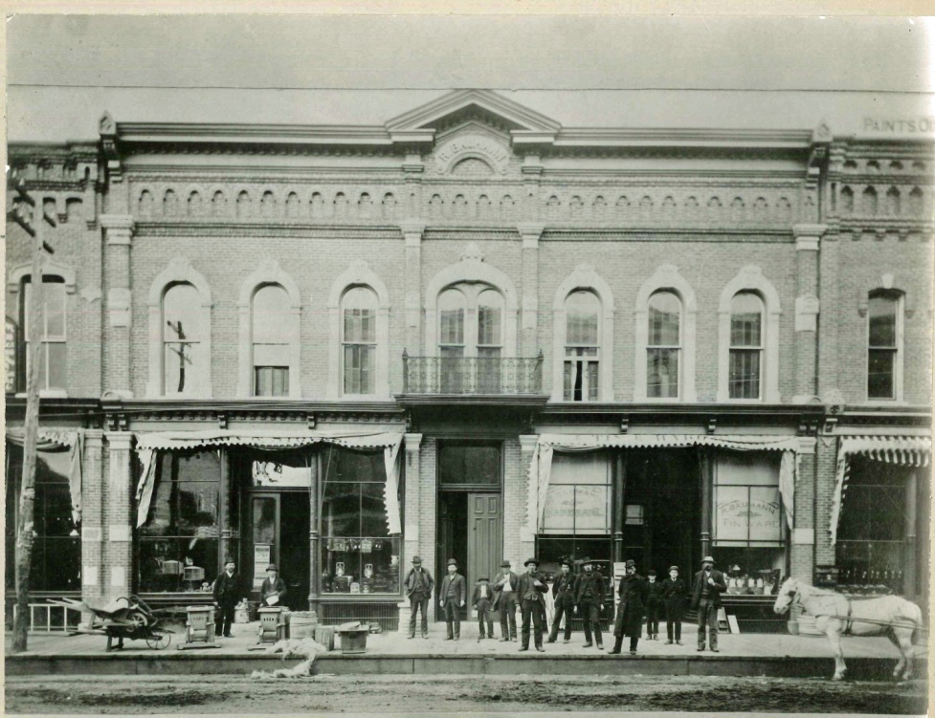
Business
The first salesmen provided supplies out of the back of their wagons.
By 1905 Wausau was filled with businesses.
By the 1910s local logging was ending.
Wausau had to transition sawmills to production companies.

Slide 13
What do you do for fun in Marathon County?
Skiing
Swimming
Movies
Parades
Fairs
Curling

Slide 14
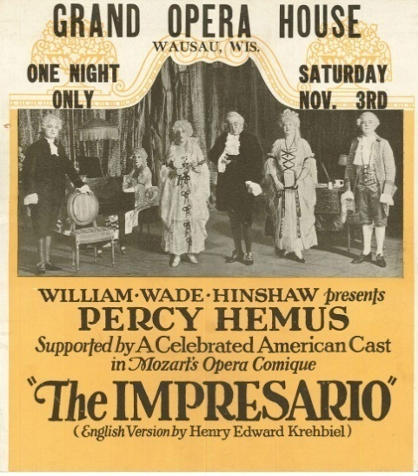
How do you have fun?
In the early 1900s fun included
  Going to the circus
  Going to parades
  Staying up late on New Year’s Eve
In the 1920s fun included
  Swimming in the Rib River
  Going to movies and plays
  Skiing in the winter
In the 1940s-1950s fun included
  Showing animals at the fair
  Joining 4-H
  Celebrating birthdays with friends

Slide 15
End of the Overview Presentation
If you would like more information about any of the topics, please see appropriate power point presentations or lesson plans.

