Slide 1
What is Marathon County?
Our Stories: The History of Marathon County Exhibit
Marathon County Historical Society

Slide 2
The World
Marathon County
www.mapsofworld.com

Slide 3
North America
Marathon County
www.mapsofworld.com

Slide 4
United States
Marathon County
geology.com

Slide 5
Wisconsin
www.thetop100lawyers.com

Slide 6
What is a county?
A county is a political division within a state
Marathon County was named after the Greek battle of Marathon
The name was picked by Walter McIndoe who helped form Marathon County.

Slide 7
Marathon County
We all live in Marathon County!
Can you find your town?
http://www.usgennet.org/usa/wi/county/clark/neighbors/marathon/history/images/TownshipMap.jpg

Slide 8
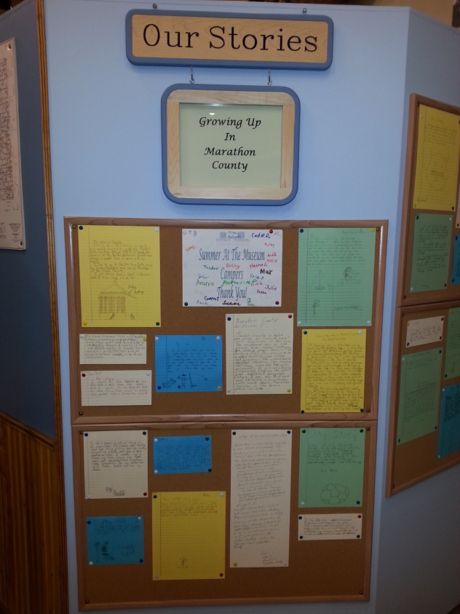
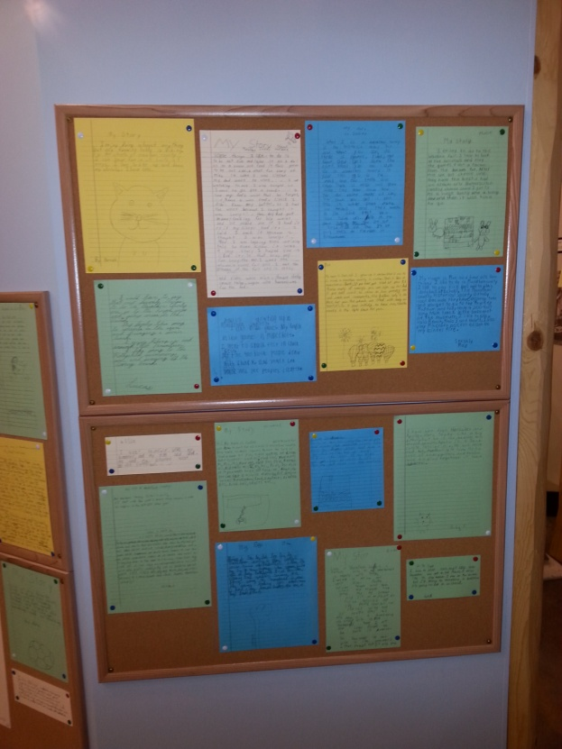
Our Stories: The History of Marathon County
This exhibit shares stories from all of the cities and towns of Marathon County.

Slide 9
End of Presentation

