Slide 1
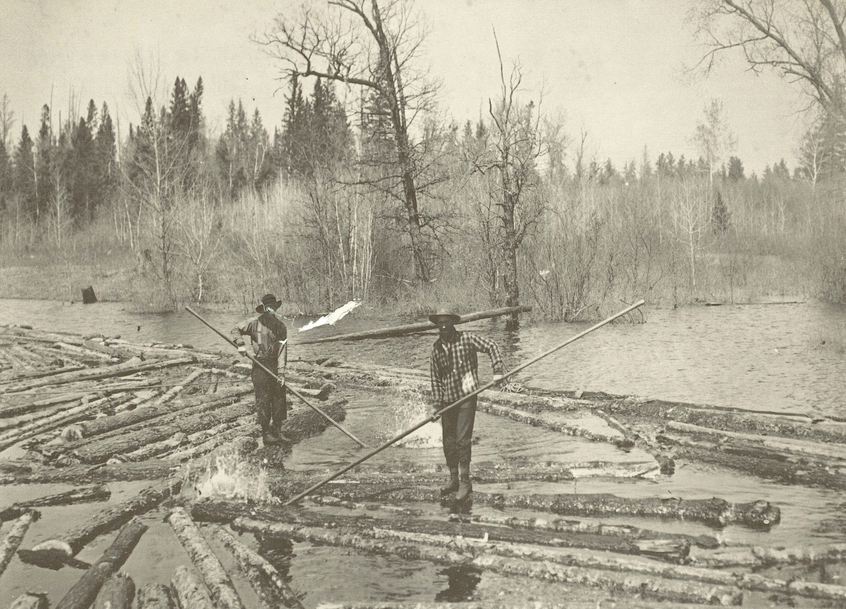
Logging Our Stories : The History of Marathon County Exhibit Marathon County Historical Society
State Standards:
B.4.1 Identify and examine various sources of information that are used for constructing an understanding of the past, such as artifacts, documents, letters, diaries, maps, textbooks, photos, paintings, architecture, oral presentations, graphs, and charts
B.4.7 Identify and describe important events and famous people in Wisconsin and United States history
A.4.8 Identify major changes in the local community that have been caused by human beings, such as a construction project, a new highway, a building torn down, or a fire; discuss reasons for these changes; and explain their probable effects on the community and the environment

Slide 2
Why did people first come to Marathon County?
George Stevens brought investors from St. Louis for lumber.
The early immigrants came for pelts

Slide 3
What time of year did they log?
“They’d go up in the fall and not come home until spring. Once home, all those clothes had to be boiled to get rid of the lice that they picked up in the lumber camp. But they earned fairly good money and they got their room and board and the feed for their horses. It was a time of year when the horses wouldn’t be doing much else.”
-Erna Zimmerman

Slide 4
What was life like in a logging camp?
“I never saw so much baked and cooked stuff in one place at one time that you saw in that kitchen. The fellow with the triangle called them in to the meal, they came in and sat down silently and immediately got to the business of eating and no words were wasted. When the boss would lay out the orders for the day and they would all get up and go out. At noontime the meals were taken on a sled to them if they were working far out in the woods and then at night was the big meal.”
-Helen Hill

Slide 5
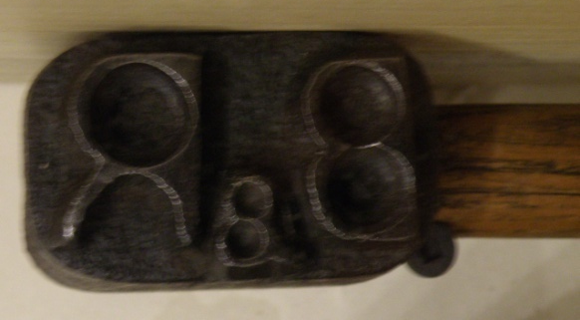
How did the logs get to the sawmills?
Horses could haul the logs over the snow and ice to river where they were stored until spring.
“My father was what they called a river pig. He worked on the logging boom on the Wisconsin River. Every log had a stamp on it, like the Barker and Steward Mill, the Mortenson Lumber Company. The logs were stamped on the end. These fellows had a plank across an open space, the rest were boomed off. As these logs came through this space they would spear them with their pike pole and send them down the channel. They sent that log into that channel, to each sawmill.”
-Marshall Duranso

Slide 6
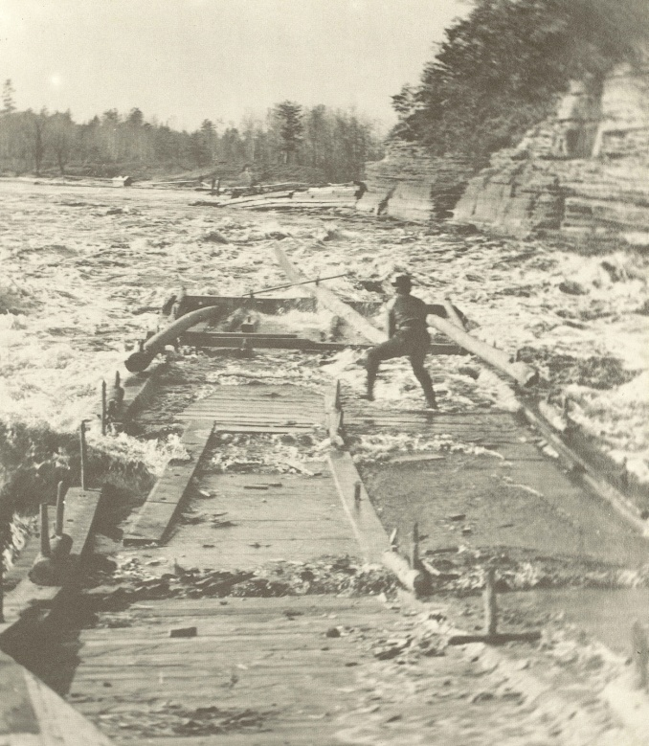
What allowed Wausau to become a hub?
The Wisconsin River flowed through Wausau
Spring logs floating downriver could easily be stopped and sent down the channels to their mills before going over the falls.

Slide 7
Why were loggers able to spread to other parts of the county?
In the 1870s the railroad was built connecting the outlying parts of Marathon County to the Wisconsin River.
Railroads allowed logs to be transported year round including winter.
Did the Lumbermen need to rely on the Wisconsin River?

Slide 8
Do you think it is possible to cut down every tree in Marathon County?
Almost all of the trees were cut down by the early 1900s

Slide 9
What happens when the trees are gone?
Move to other logging sites
Where else could lumbermen go for logs?
Begin a different business
What other type of businesses could be started in Marathon County?

Slide 10
Discussion Questions
Why would the Wisconsin River be a difficult source to use for transportation?
Who was working in the sawmills?
What was needed to process the logs?
Why did some small sawmills only stay open for a few years?
Why did cities remain after the logging ended?

Slide 11
End of Logging presentation

