Slide 1
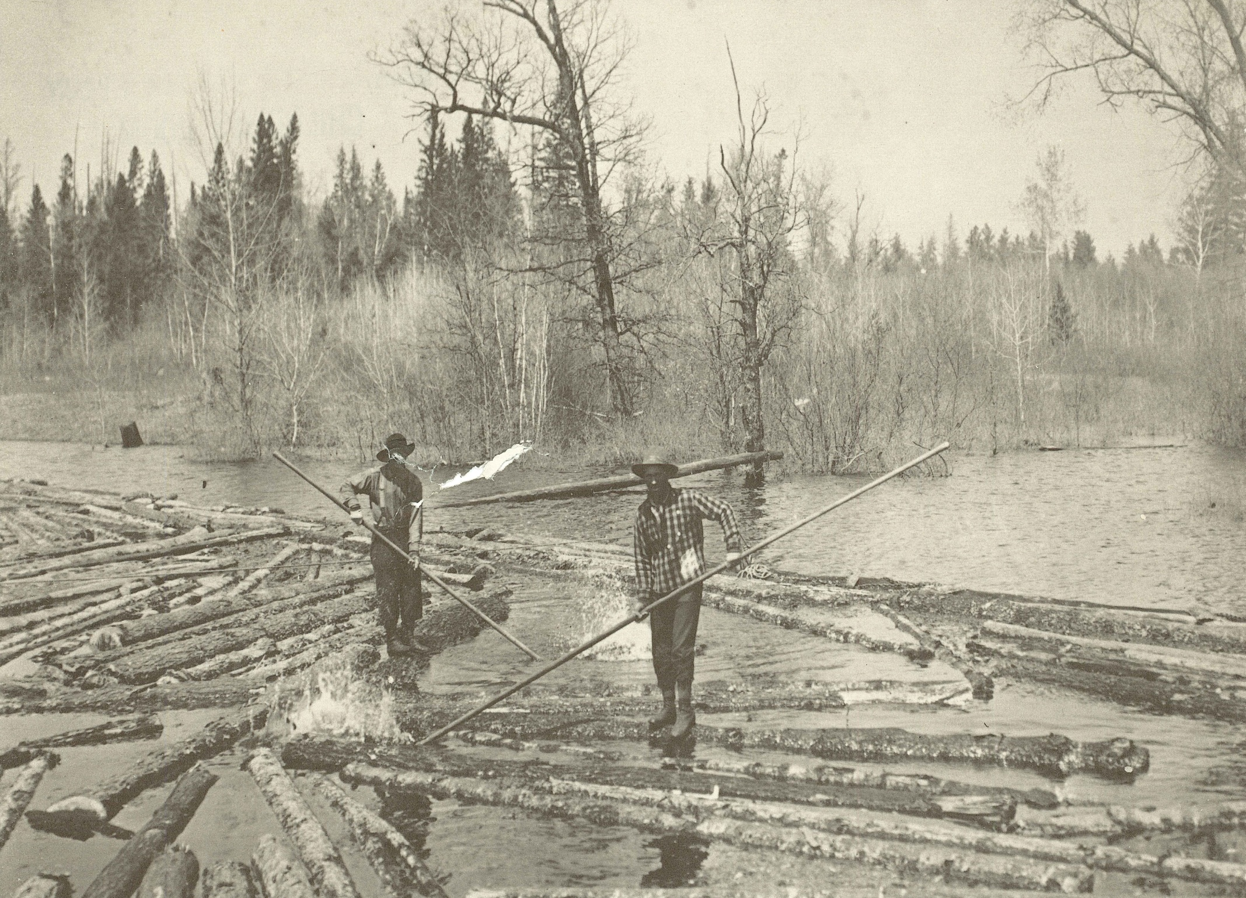
Logging
Our Stories: The History of Marathon County Exhibit
Marathon County Historical Society
State Standards:
B.8.1 Interpret the past using a variety of sources, such as biographies, diaries, journals, artifacts, eyewitness interviews, and other primary source materials, and evaluate the credibility of sources used,
A.8.4 Conduct a historical study to analyze the use of the local environment in a Wisconsin community and to explain the effect of this use on the environment.

Slide 2
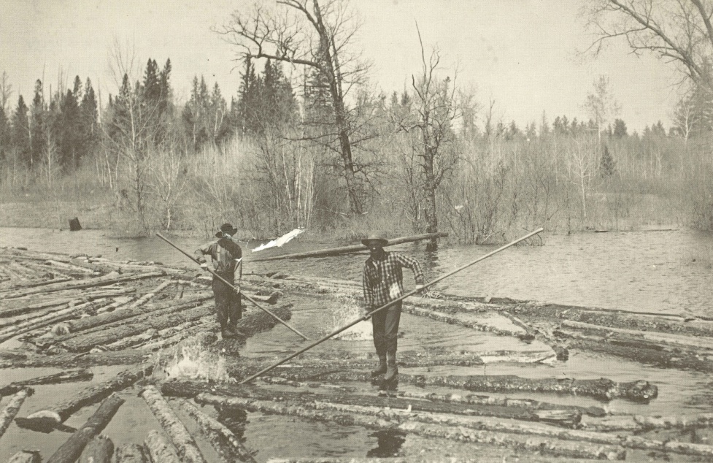
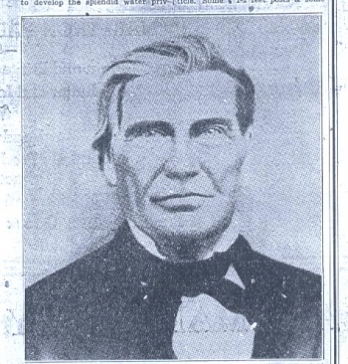
Why did people first come to
Marathon County?
In 1839 George Stevens brought financial baking from St. Louis for lumber
The early immigrants came for pelts

Slide 3
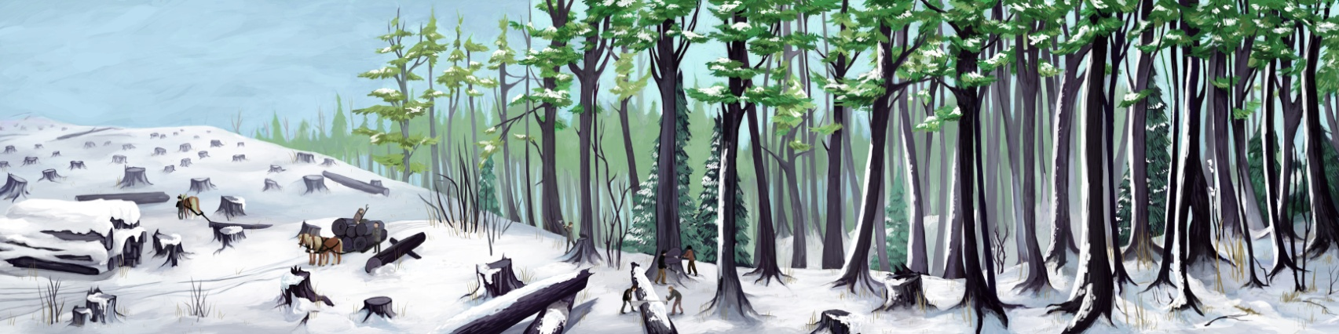
What time of year did they log?
“They’d go up in the fall and not come home until spring. Once home, all those clothes had to be boiled to get rid of the lice that they picked up in the lumber camp. But they earned fairly good money and they got their room and board and the feed for their horses. It was a time of year when the horses wouldn’t be doing much else.”
-Erna Zimmerman

Slide 4
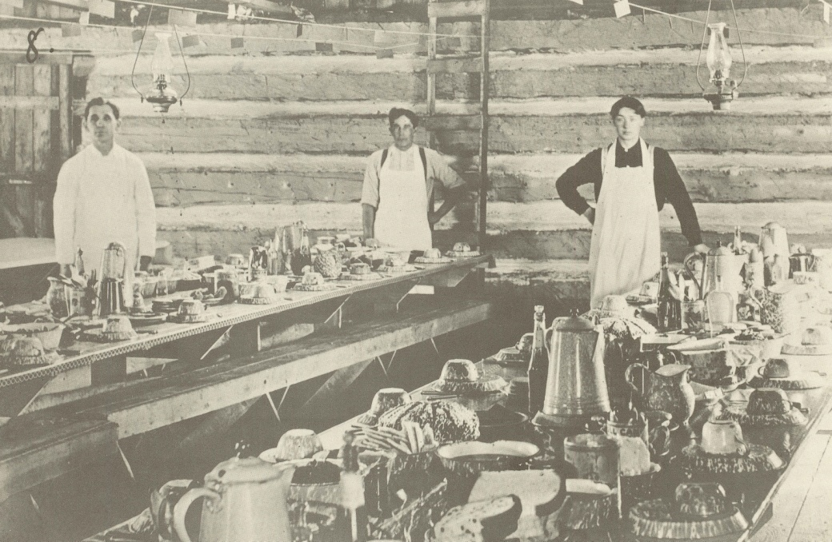
What was life like in a logging camp?
“Those men had to be out in the woods long before daybreak, around 5 o’clock in the morning, and then they would bring a lunch to them at noon and they worked until it was dark in those days. There were no eight-hour day or anything like that.”
-Father Rudolph Raschke

Slide 5
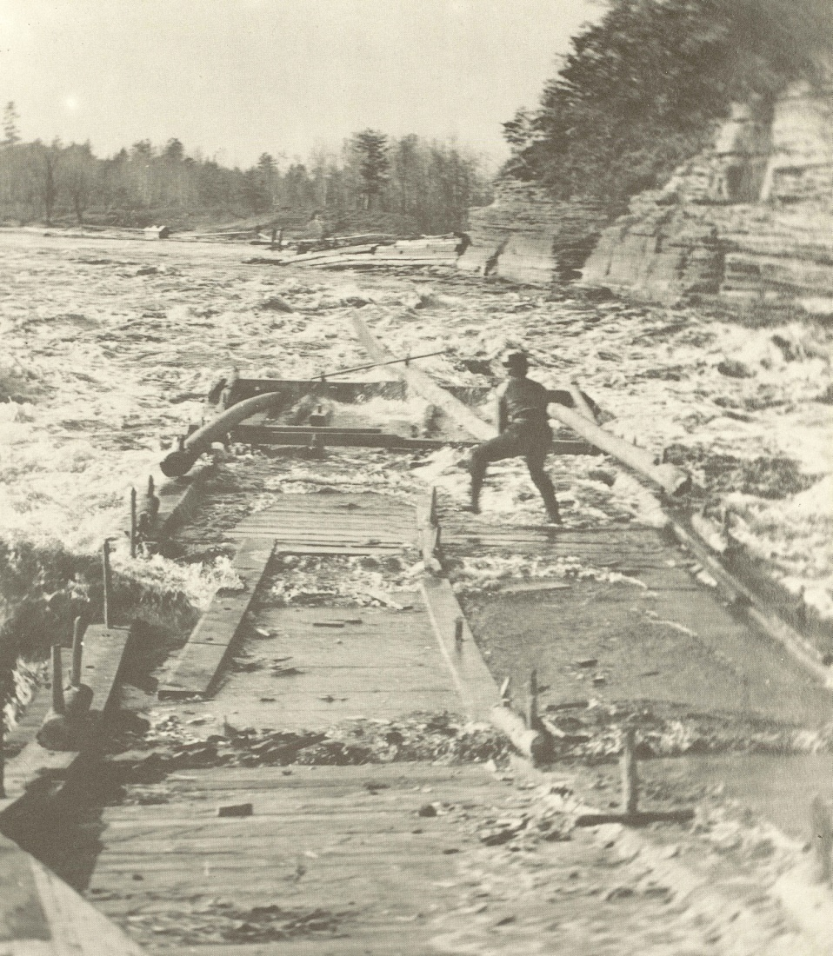
What was the life expectancy of a River Rat?
“My grandfather nearly lost his life at Mosinee in what is known as Little Bull Falls. They were rafting lumber down the river. Many men, in pulling these rafts through the rapids or falls, were thrown out of the rafts and if they were thrown under the rafts their bodies would be crushed against the rocks below. My grandfather did fall off a raft at Little Bull Falls but one of the men saw him and was able to catch an arm and pull him back on board before the current pulled him under the raft.”
-Jacob Gensman

Slide 6
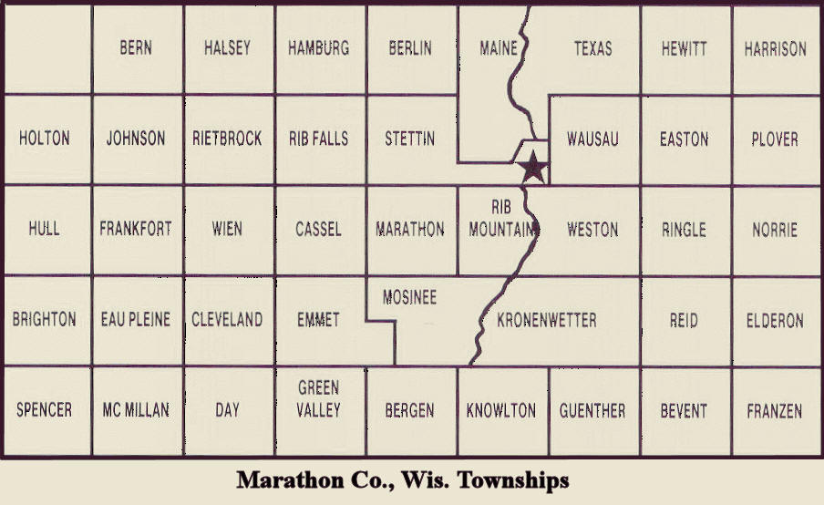
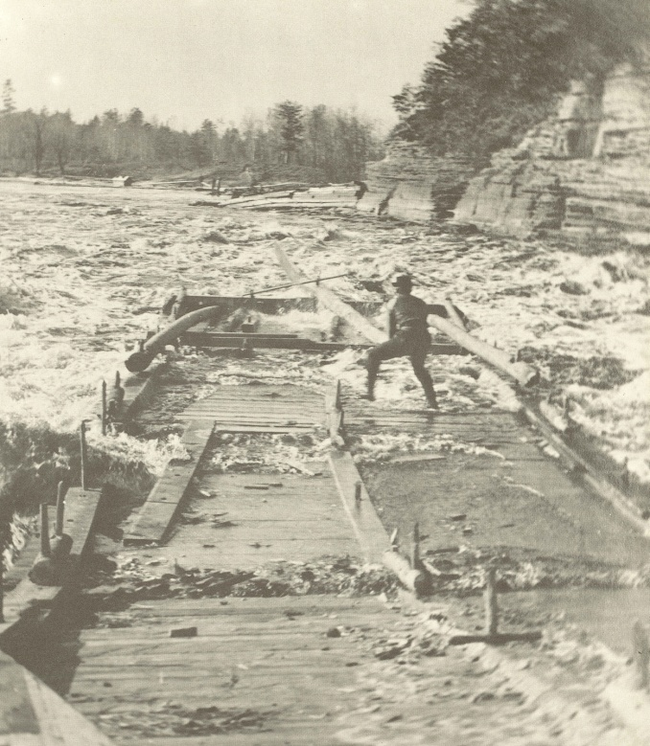
What allowed Wausau to become a hub?
The Wisconsin River flowed through Wausau
Spring logs floating downriver could easily be stopped and sent down the channels to their mills before going over the falls.

Slide 7
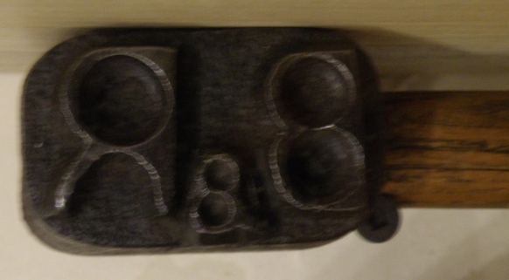
How did the logs get to the sawmills?
Horses could haul the logs over the snow and ice to river where they were stored until spring.
“My father was what they called a river pig. He worked on the logging boom on the Wisconsin River. Every log had a stamp on it, like the Barker and Steward Mill, the Mortenson Lumber Company. The logs were stamped on the end. These fellows had a plank across an open space, the rest were boomed off. As these logs came through this space they would spear them with their pike pole and send them down the channel. They sent that log into that channel, to each sawmill.”
-Marshall Duranso

Slide 8
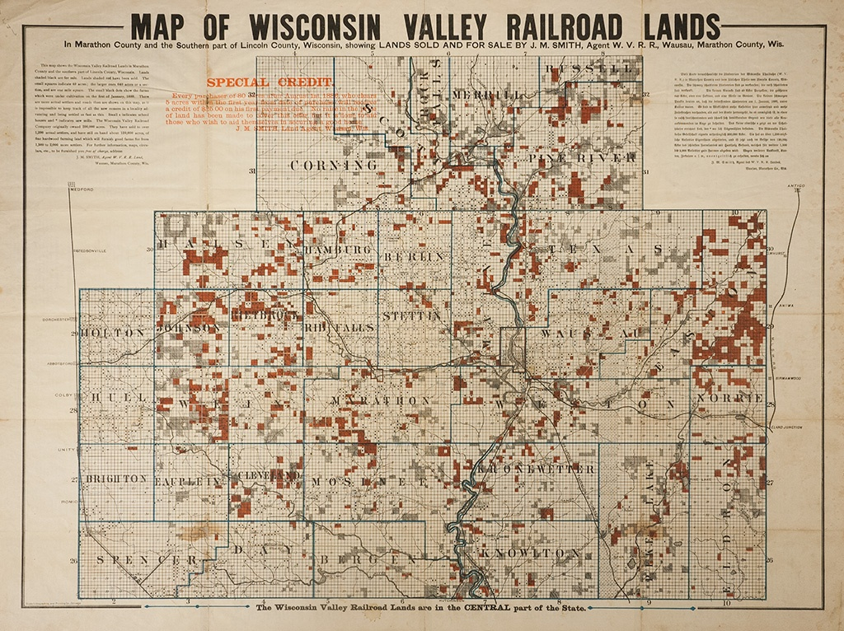
Why were loggers able to spread to other parts of the county?
In the 1870s the railroad was built connecting the outlying parts of Marathon County to the Wisconsin River.
Railroads allowed logs to be transported year round including winter.
Did the Lumbermen need to rely on the Wisconsin River?

Slide 9
What happens when the trees are gone?
Move to other logging sites
  Where else could lumbermen go for logs?
Begin a different business
  What other type of businesses could be started in Marathon County?

Slide 10
Discussion Questions
Why would the Wisconsin River be a difficult source to use for transportation?
Who was working in the sawmills?
What was needed to process the logs?
Why would some sawmills only stay open for a few years?
Why did cities remain after the logging ended?

Slide 11
End of Logging presentation

