Slide 1
Marathon County Originals
Our Stories: The History of Marathon County Exhibit
Marathon County Historical Society
State Standards:
B.4.7 Identify and describe important events and famous people in Wisconsin and United States history
B.4.4 Compare and contrast changes in contemporary life with life in the past by looking at social, economic, political, and cultural roles played by individuals and groups
D.4.3 Identify local goods and services that are part of the global economy and explain their use in Wisconsin
D.4.4 Give examples to explain how businesses and industry depend upon workers with specialized skills to make production more efficient.

Slide 2

Name an item made in Marathon County
Ringle Bricks
Wausau Homes
Silver Fox Fur
Ginseng

Slide 3
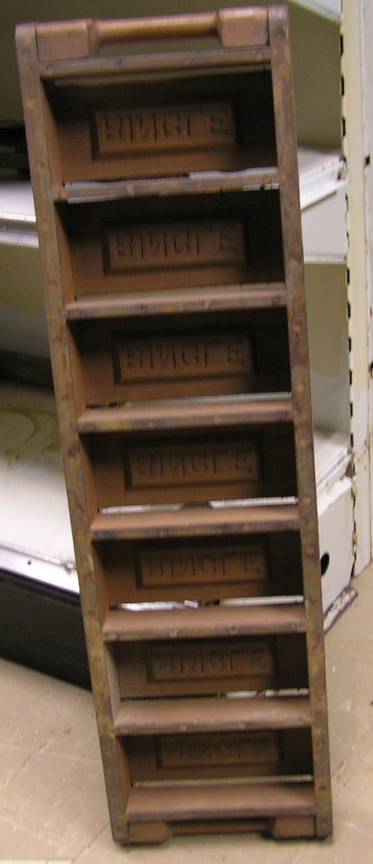
What can you make out of clay?
By adding pulverized hard shale, John Ringle created the distinctive burnt orange colored bricks.
Originally he owned a sawmill on the land, but too much clay forced the mill to close in 1904.

Slide 4
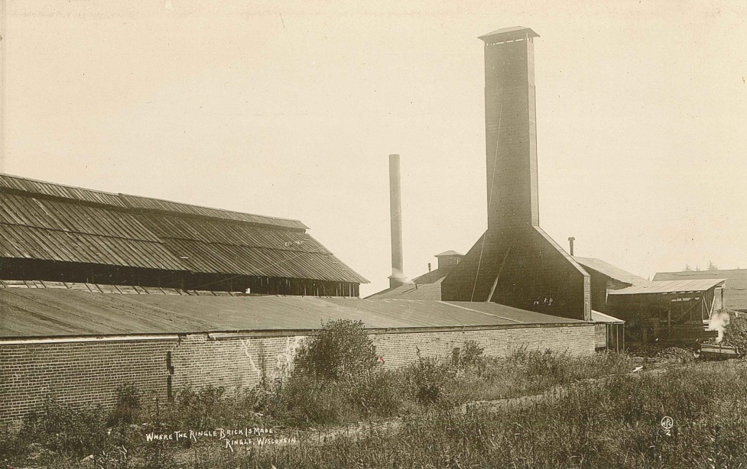
This building is made from Ringle Bricks
The bricks in this building came from the Ringle Brickyard.
Former Wausau Mayor John Ringle started the brickyard.
Ringle brickyard ceased production in 1943.
Ringle Brick Factory

Slide 5
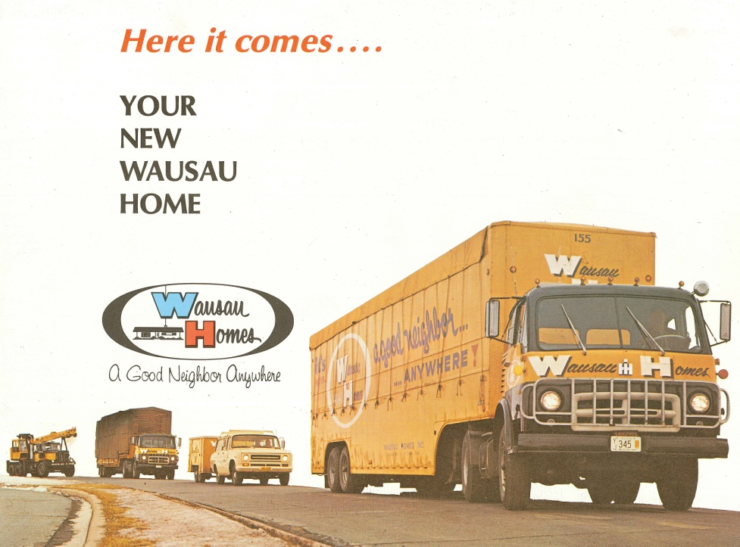
If you had to move away from Marathon County, would you take your house?
Houses are built in components and shipped down the road.
Once arriving at their location, they are assembled.
Wausau Homes was the first company in Marathon County to build homes this way.

Slide 6
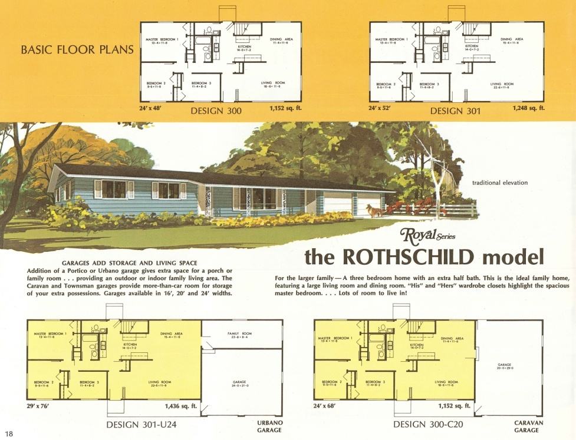
How is this done?
The components are built in a factory.
Everything is in the house, plumbing, electricity, flooring, even the doors!
The components travel on special carriers to their destination where they are assembled.

Slide 7

How much does a Wausau Home cost?
In 1964 a 3 bedroom home with a garage cost $8950.00.
Today a 3 bedroom home with a garage cost $200,000.

Slide 8

Are Wausau Homes only in Wausau?
They are in every state.
They are on four continents,
  North America
  South America
  Asia
  Africa

Slide 9
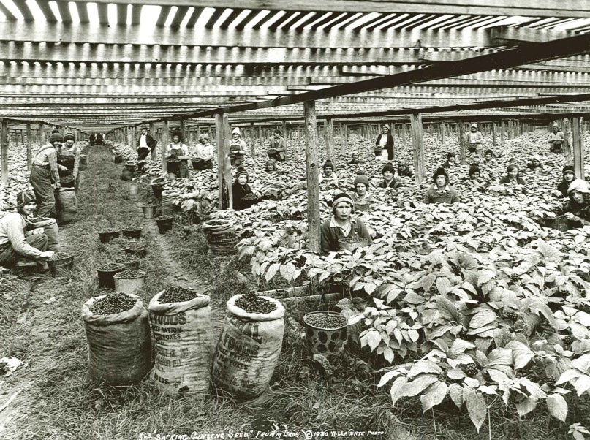
Name this Crop!
Found naturally growing in Marathon County
Farmers started cultivating it in the 1890s
Can take up to five years to grow
Used medicinally in China
Provided enough money for the Fromm Brothers to start their fur farm

Slide 10
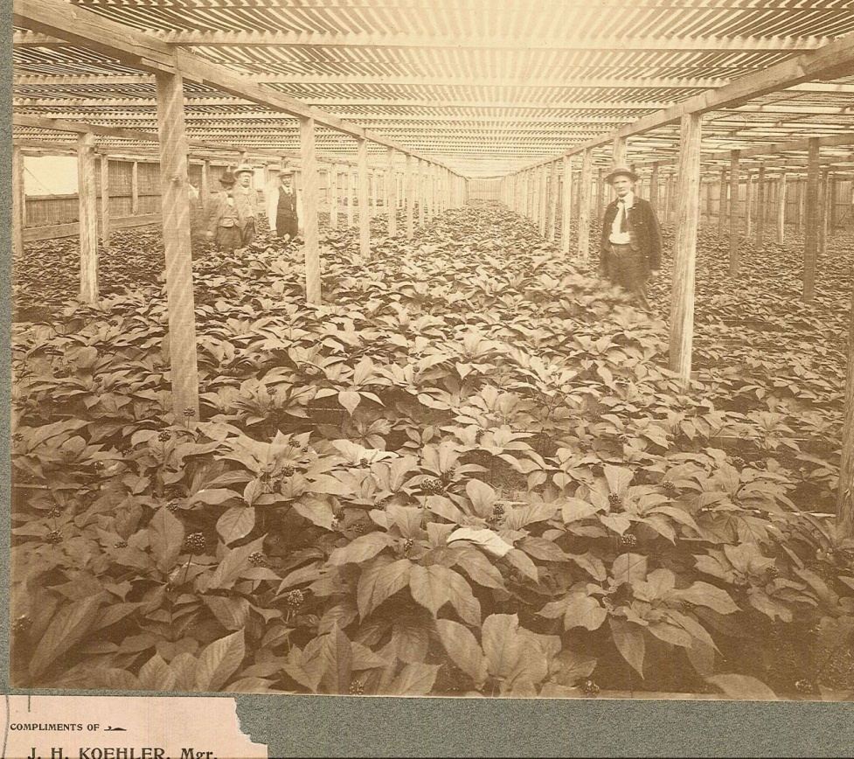
Ginseng!
“King of Ginseng” John Koehler made a $5.00 profit per pound in the early 1900s
He grew 4,000 pounds per acre
How much profit per acre did he make?
$20,000 per acre

Slide 11
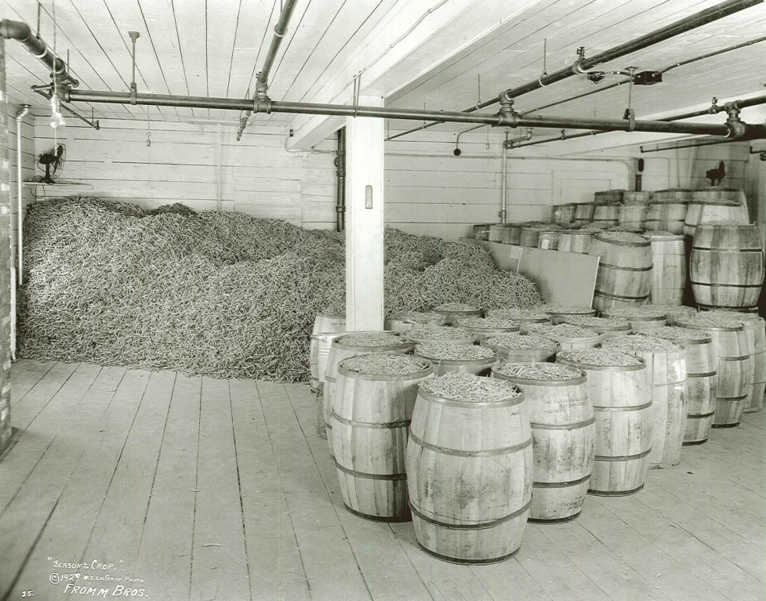
Fromm Brothers take the lead
By 1919 the Fromm Brothers were the top ginseng producers in the U.S.
They invented new techniques.
They used machinery for cultivation.
The created moveable wooden arbors.

Slide 12
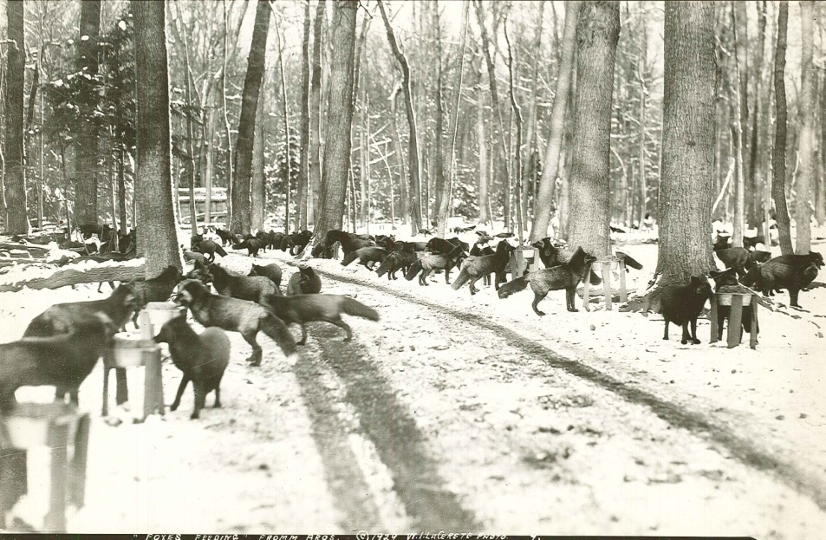
What is a Silver Fox?
A Fairy tale?
A rare fox known for having a sliver sheen in its fur.
It was very popular to wear in the 1930-1940s.
Brothers, Walter, Edward, John, and Henry Fromm dreamed of raising silver foxes.
They raised the funds to fulfill their dream by raising ginseng.

Slide 13
How did they raise Silver Foxes?
The brothers provided wooded ranges to provide shade.
The also needed to prevent boredom so the animals would not damage their fur.
The Fromms also created a distemper vaccine to keep animals healthy.

Slide 14
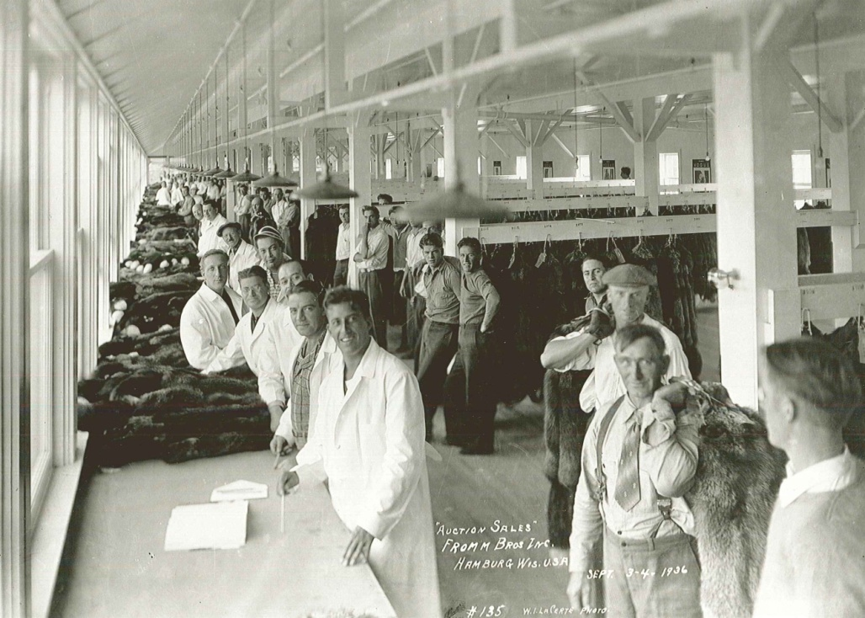
Where were the furs sold?
Ebay
Commercials
Newspapers and magazines
Auctions
Answer:
Auctions, some sold for thousands of dollars

Slide 15
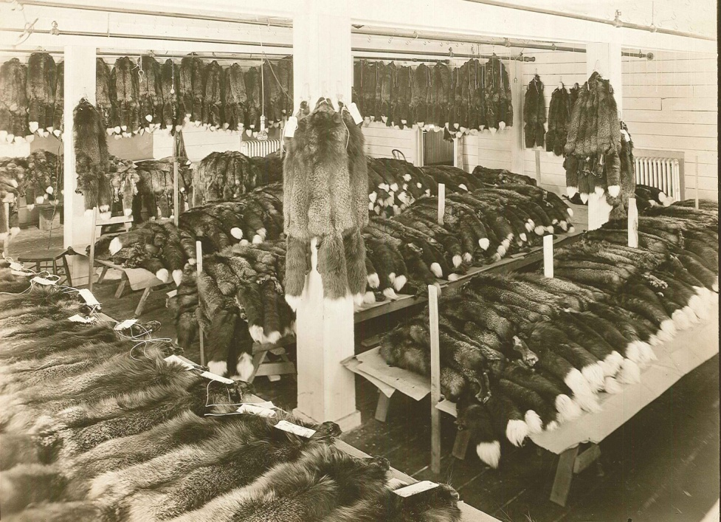
Are the Fromm Brothers still in business today?
No
Why do you think they would have gone out of business?
Fashions changed causing sales to decline.
The company split up in 1964.

Slide 16
Discussion Questions
Do you think John Ringle should have kept his sawmill going along with the brickyard? Why or why not?
How is a Wausau home different from other homes?
Why do you think houses cost so much more today?
Do you think the Fromm brothers would make faux fur today if they were still in business? Why or why not?
Pick two companies to compare and contrast.

Slide 17
End of Marathon County Originals Presentation

