Slide 1
Marathon County Originals
Our Stories: The History of Marathon County Exhibit
Marathon County Historical Society
State Standards:
A.8.8 Describe and analyze the ways in which people in different regions of the world interact with their physical environments through vocational and recreational activities
D.8.3 Describe Wisconsin's role in national and global economies and give examples of local economic activity in national and global markets
D.8.8 Explain how and why people who start new businesses take risks to provide goods and services, considering profits as an incentive

Slide 2

Name an item made in Marathon County
Ringle Bricks
Wausau Homes
Silver Fox Fur
Ginseng

Slide 3
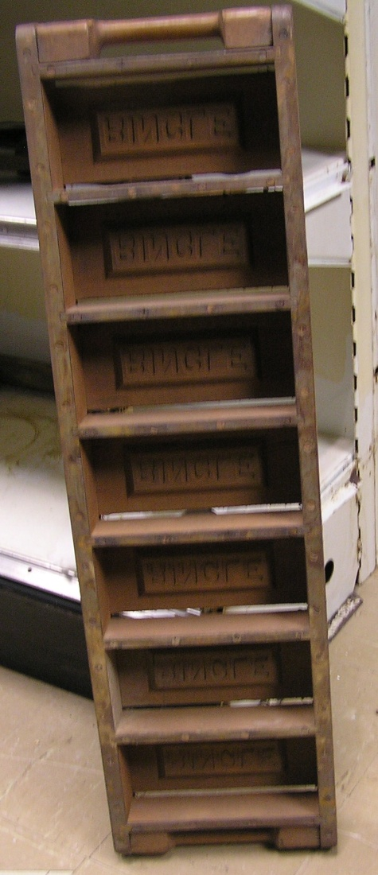
What can you make out of clay?
By adding pulverized hard shale, John Ringle created the distinctive burnt orange colored bricks.
Originally he owned a sawmill on the land, but too much clay forced the mill to close in 1904.

Slide 4
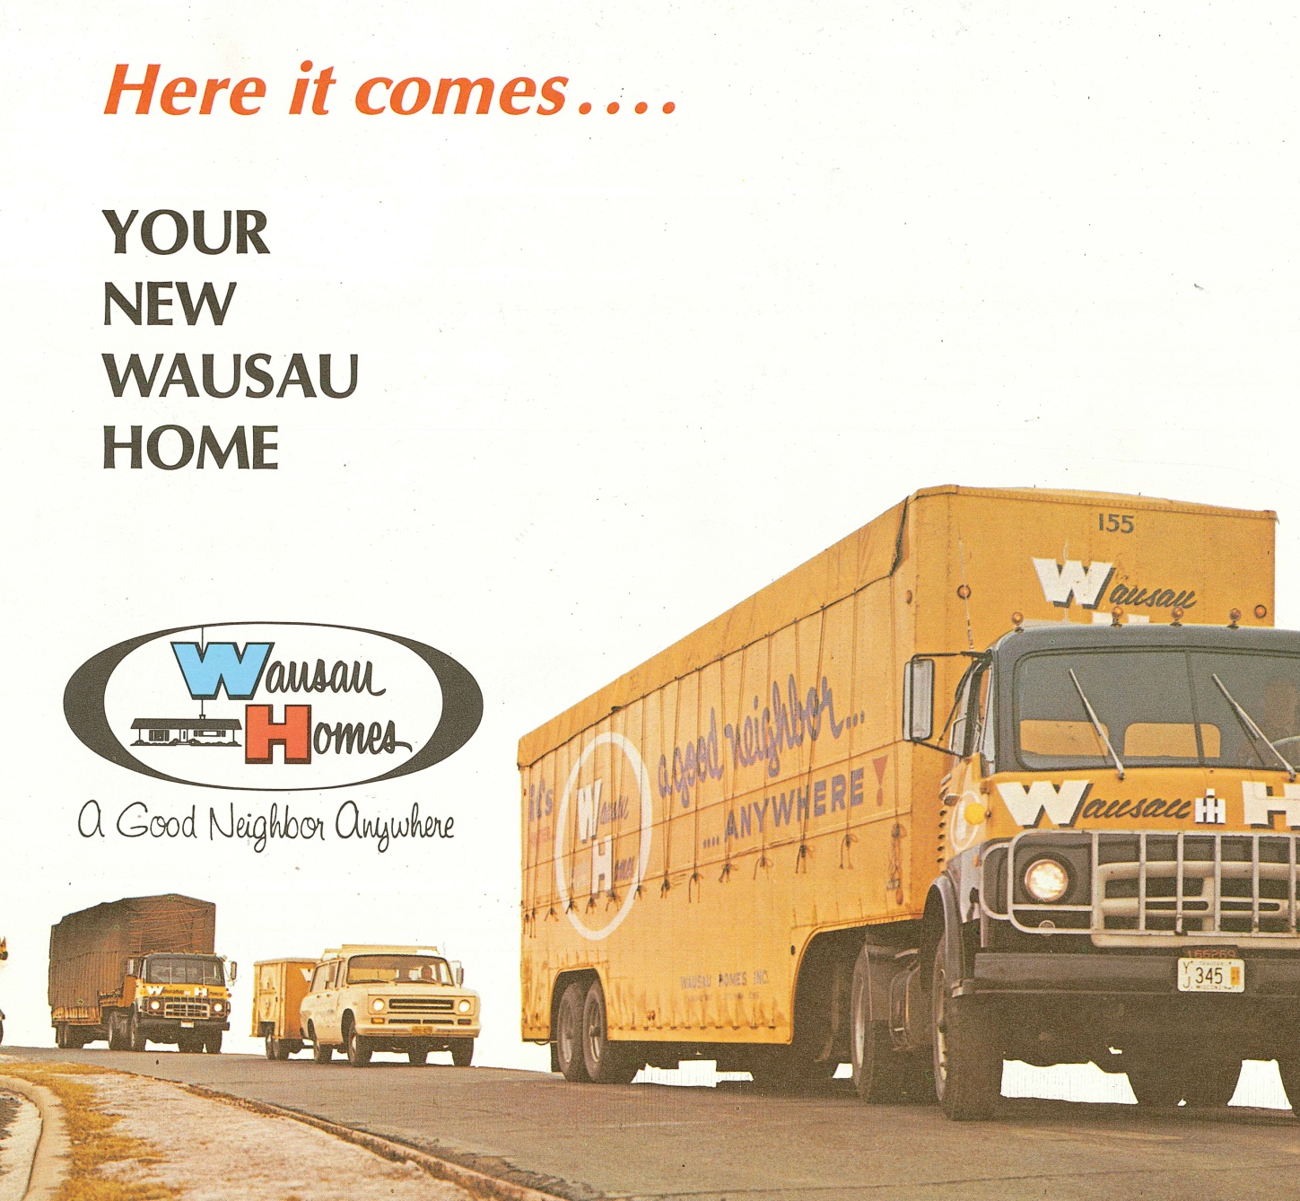
Can you tell if a house has been shipped down the road?
Wausau Homes were the first company in Marathon County to build homes this way.

Slide 5

Floor Plan
The house is built in components.
Everything is in place, plumbing, electricity, flooring, even the doors.

Slide 6
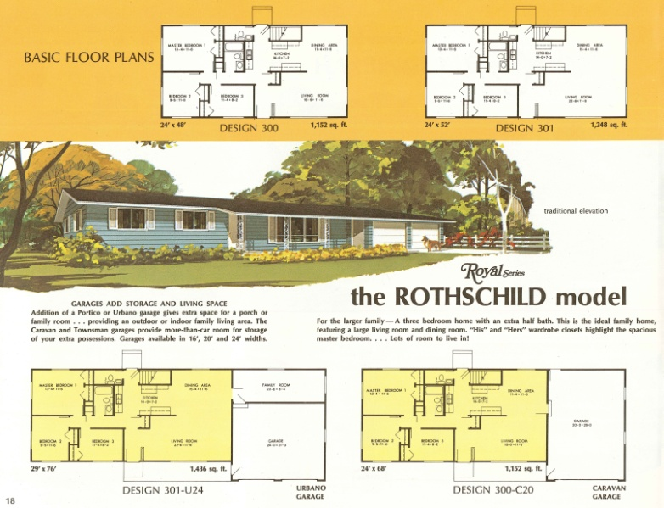
Is this cost effictive?
Construction crews work inside a factory, weather does not slow down progress.
All tools and personnel are onsite
4,000 homes are built a year
A 3 bedroom home with a garage was $8,950 in 1964
Today the same home would be $200,000

Slide 7

How far can Wausau Homes be shippied?
They are across the U.S.
Around the world
  North America
  Latin America
  Middle East
  Africa

Slide 8
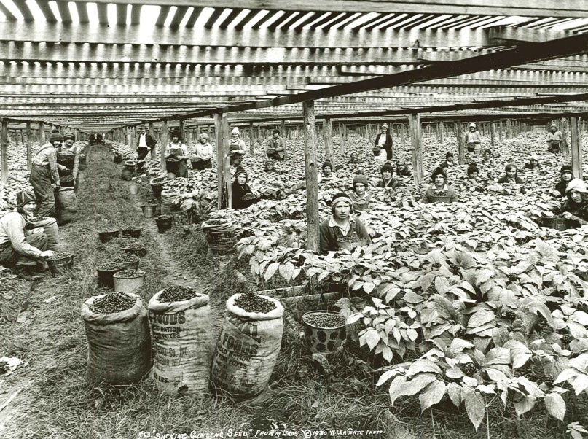
Name this Crop!
Found naturally growing in Marathon County
Farmers started cultivating it in the 1890s
Can take up to five years to grow
Used medicinally in China
Provided enough money for the Fromm Brothers to start their fur farm

Slide 9
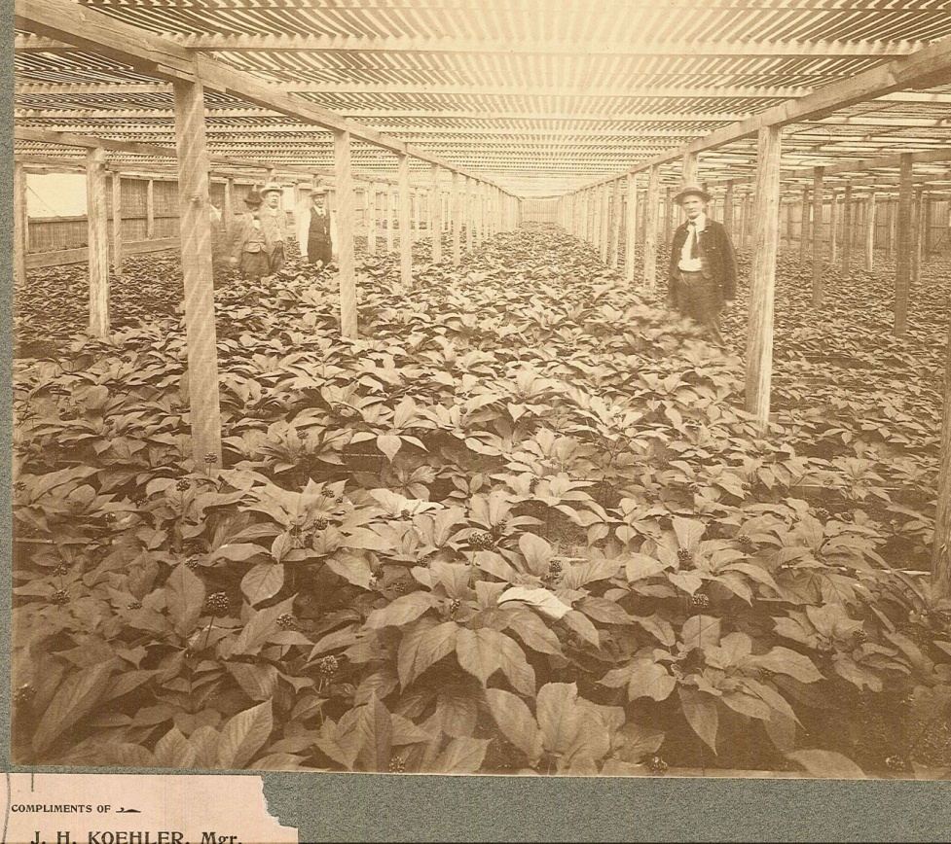
Ginseng!
“King of Ginseng” John Koehler made a $5.00 profit per pound in the early 1900s
He grew 4,000 pounds per acre
How much profit per acre did he make?
$20,000 per acre

Slide 10
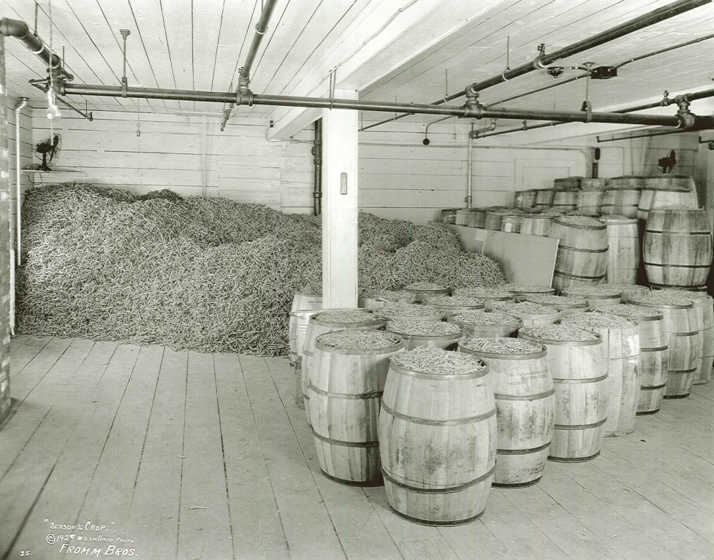
Fromm Brothers take the lead
By 1919 the Fromm Brothers were the top ginseng producers in the U.S.
They invented new techniques.
They used machinery for cultivation.
The created moveable wooden arbors.

Slide 11
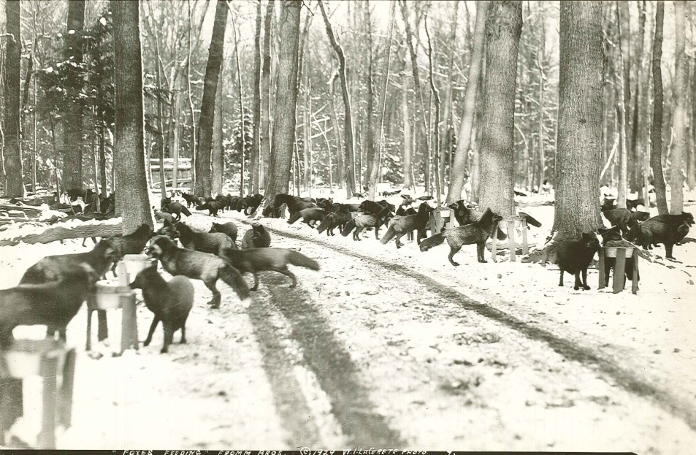
What is a Silver Fox?
A Fairy tale?
A rare fox known for having a sliver sheen in its fur.
It was very popular to wear in the 1930-1940s.
Brothers, Walter, Edward, John, and Henry Fromm dreamed of raising silver foxes.
They raised the funds to fulfill their dream by raising ginseng.

Slide 12
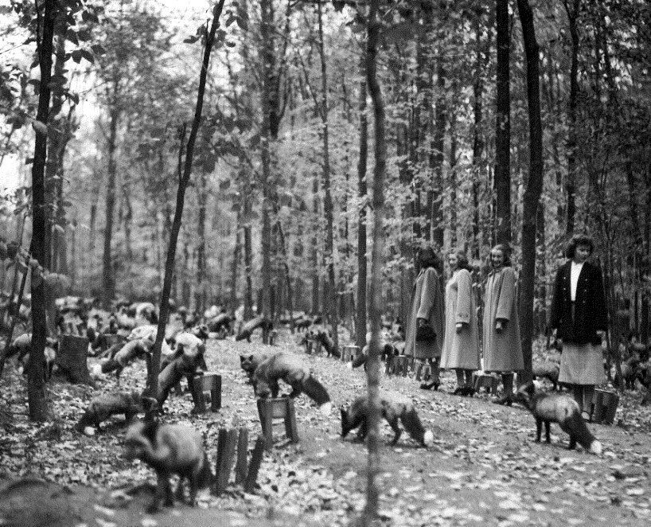
How did they raise Silver Foxes?
The brothers provided wooded ranges to provide shade.
The also needed to prevent boredom so the animals would not damage their fur.
The Fromms also created a distemper vaccine to keep animals healthy.

Slide 13
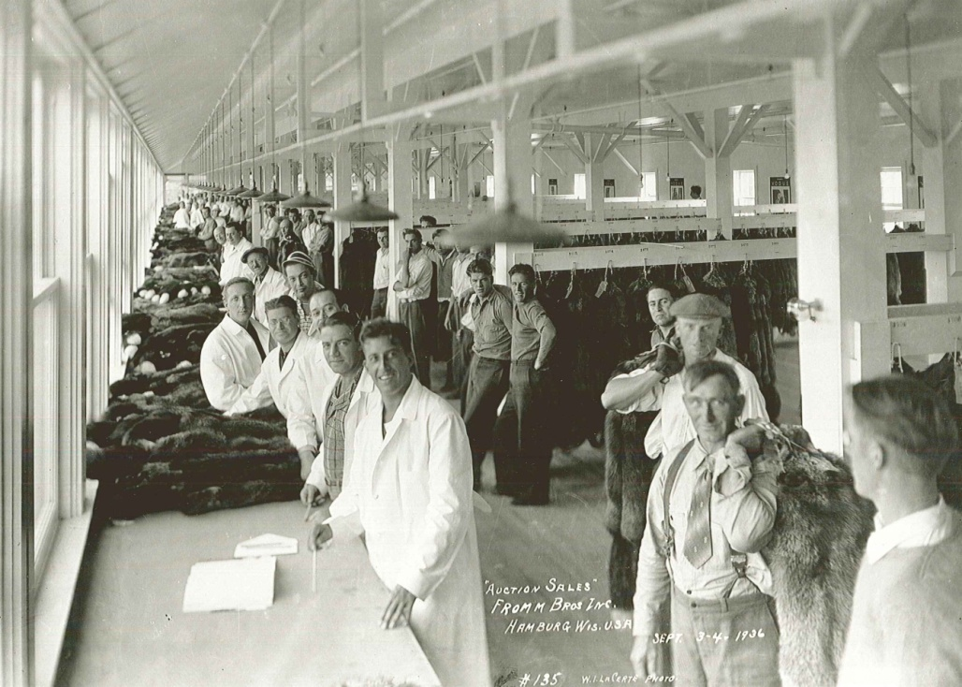
Where were the furs sold?
Ebay
Commercials
Newspapers and magazines
Auctions
Answer:
Auctions, some sold for thousands of dollars

Slide 14
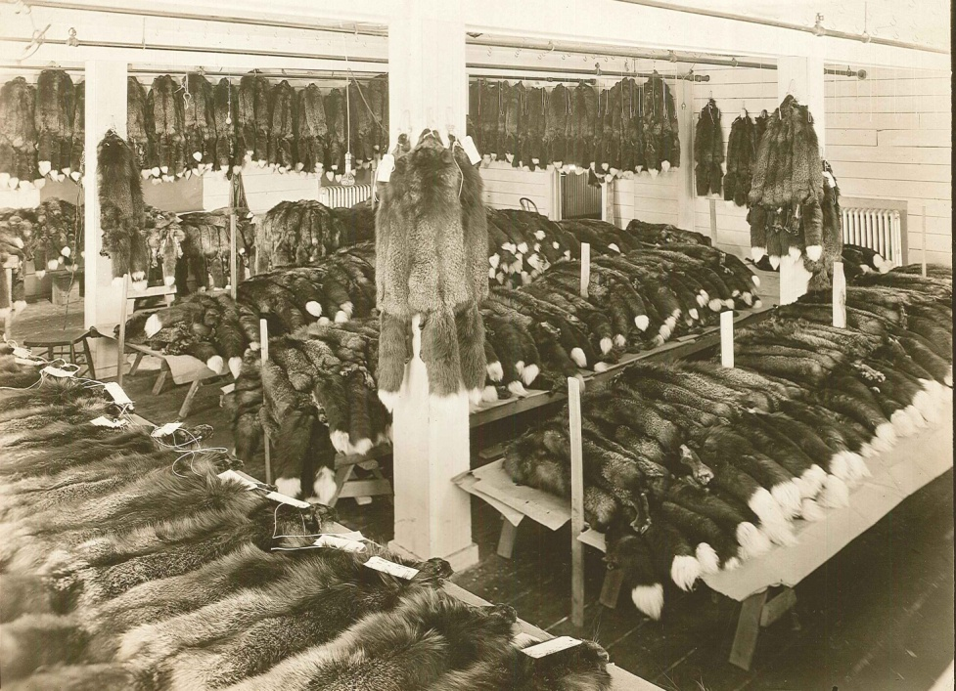
Are the Fromm Brothers still in business today?
No
Why do you think they would have gone out of business?
Fashions changed causing sales to decline.
The company split up in 1964.

Slide 15
Discussion Questions
Do you think John Ringle should have kept his sawmill going along with the brickyard? Why or why not?
How is a Wausau home different from other homes?
Why do you think houses cost so much more today?
Do you think the Fromm brothers would make faux fur today if they were still in business? Why or why not?
Pick two companies to compare and contrast.

Slide 16
End of Marathon County Originals Presentation

